Slide 1
Main Figures

Slide 2
 | HEU | HEI
n | 40 | 35
Gender, Female, n (%) | 23 (58%) | 20 (57%)
Age at study enrollment, days, median [IQR] | 33 [31-52.75] | 34 [31-73]
Plasma virus load, median [IQR] | n/a | 594,132 [176,970-4,284,389]
Days to first virus suppression <20 c/ml, median | n/a | 303 [173.3-528.3]
CD4 count/mm3, median | n/a | 1990 [1446-2387]
Notes:
Table 1

Slide 3
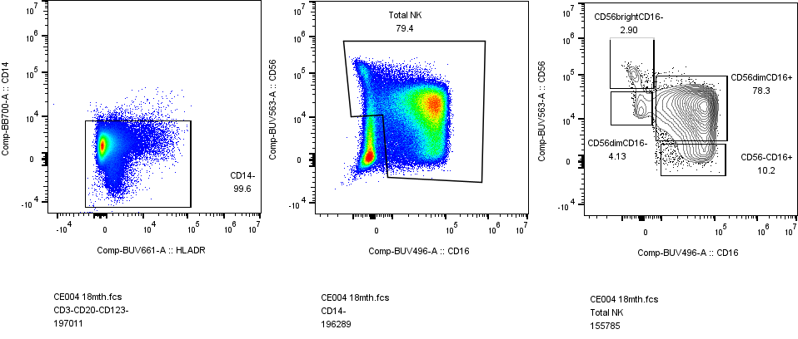
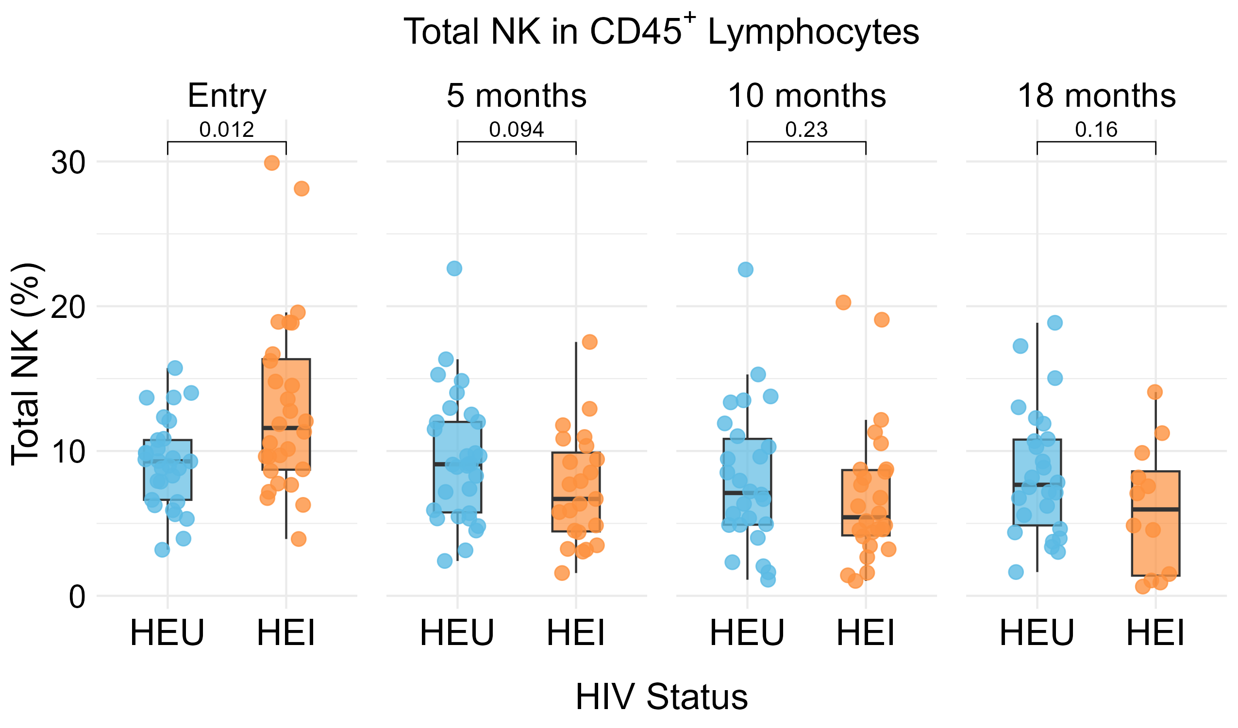
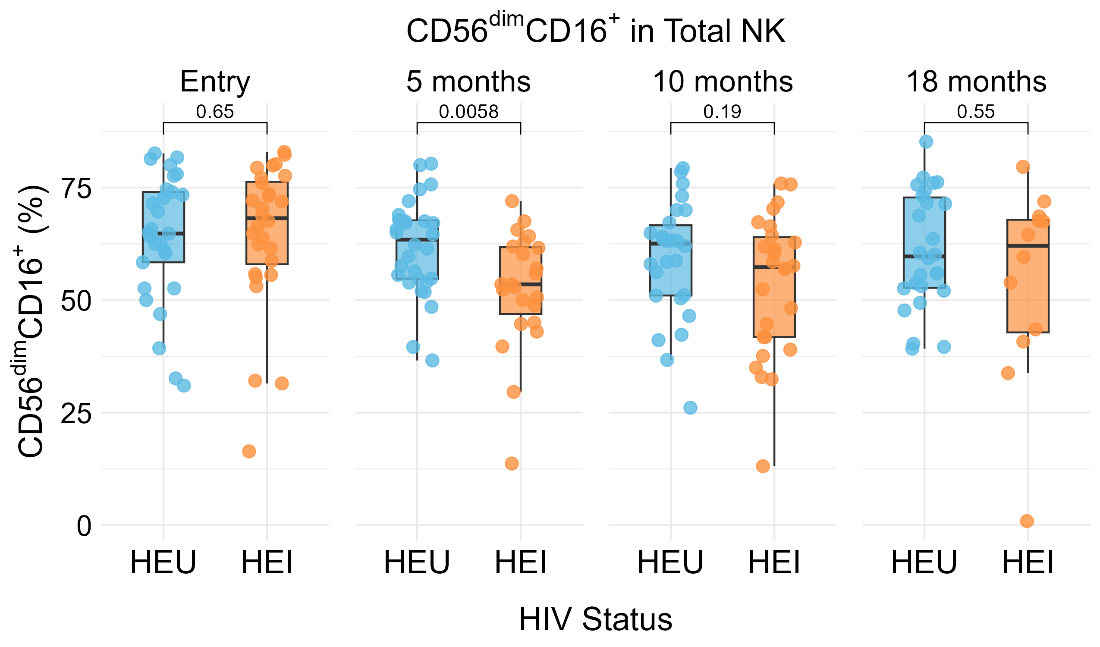
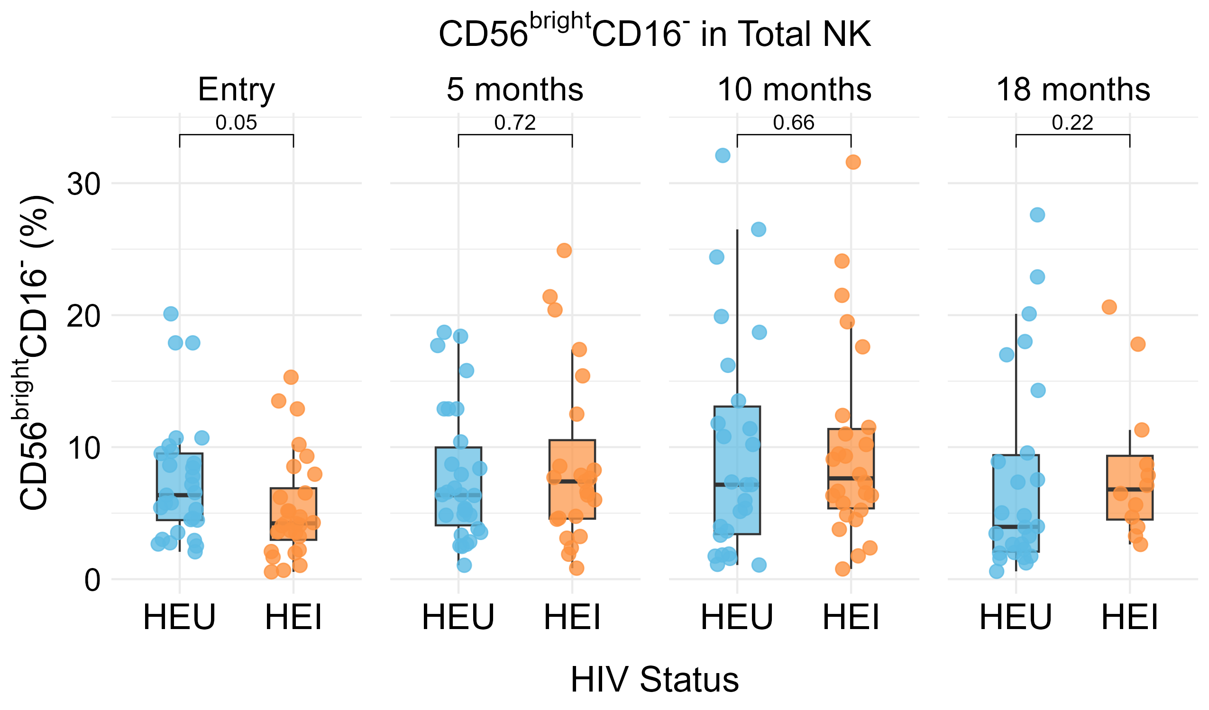
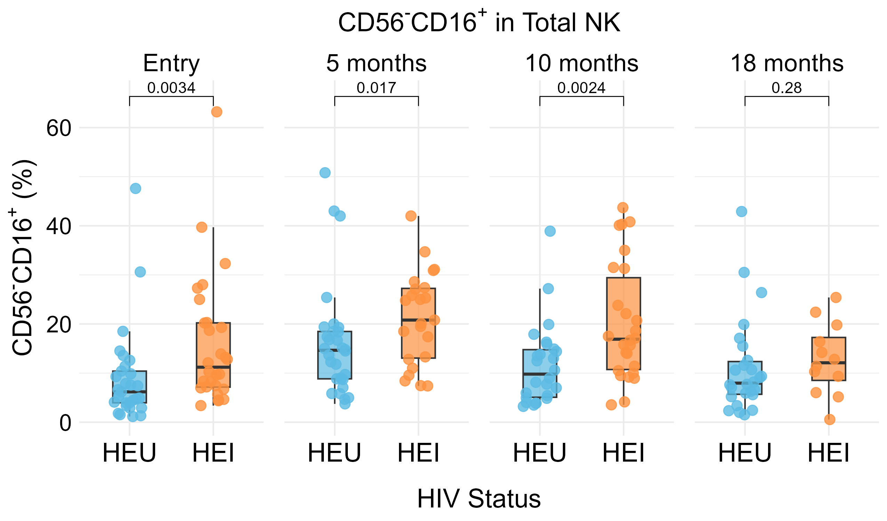
A
B
CD56
CD16
C
D
E
Notes:
Figure 1

Slide 4
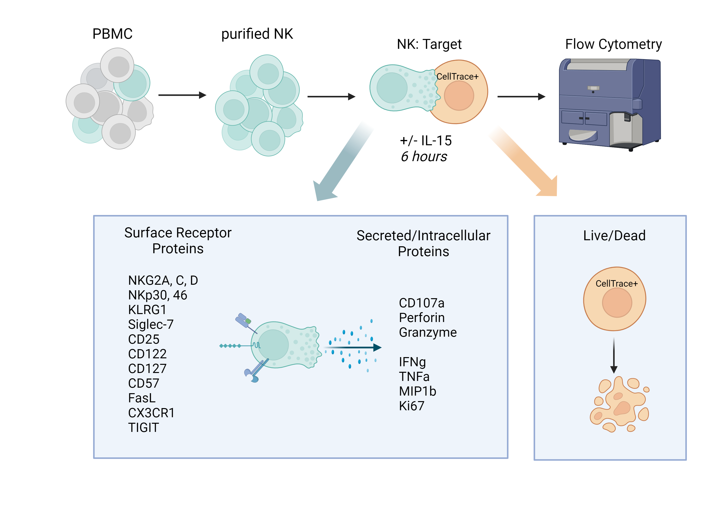
A
B
CEM
HUT78/SF2
K562
p=0.52
p=0.51
p=0.11
HEU
Specific Killing %
p=0.16
p=0.28
p=0.70
HEI
C
D
Entry
12m
Entry
12m
Entry
12m
CEM
HUT78/SF2
K562
CEM
HUT78/SF2
K562
p=0.16
p=0.04
p=0.10
p=0.04
p=0.01
p=0.01
&
&
&
&
HEU
HEU
IFNy+ CD56dimCD16+ %
CD107a+ CD56dimCD16+ %
p=0.01
p=0.17
p=0.10
p=0.04
HEI
p=0.02
p=0.003
HEI
E
Entry
12m
Entry
12m
Entry
12m
F
Entry
12m
Entry
12m
Entry
12m
CEM
HUT78/SF2
K562
CEM
HUT78/SF2
K562
p=0.37
p=0.23
p=0.07
p=0.61
p=0.14
p=0.53
#
&
HEU
HEU
TNF+ CD56dimCD16+ %
MIP1b+ CD56dimCD16+ %
p=0.71
p=0.009
p=0.14
p=0.001
HEI
p=0.08
p=0.01
HEI
Entry
12m
Entry
12m
Entry
12m
Entry
12m
Entry
12m
Entry
12m
Notes:
Figure 2

Slide 5
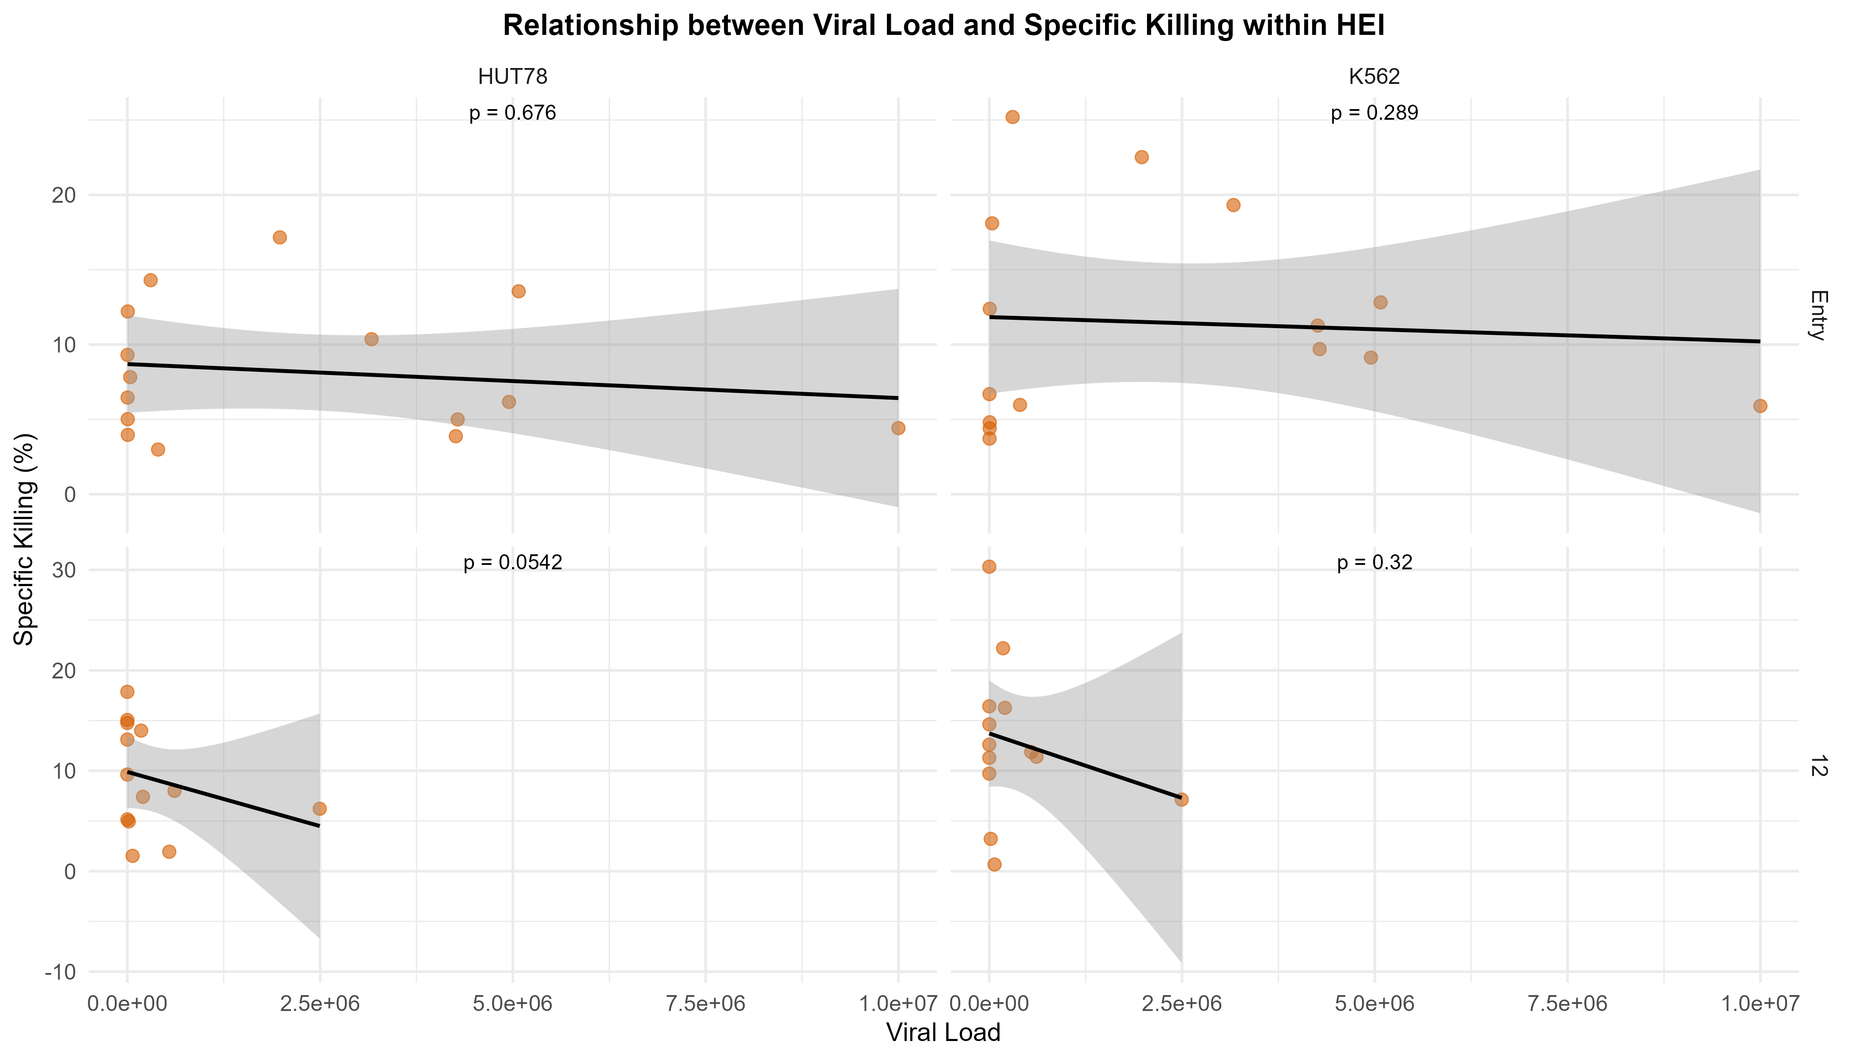
Remove CEM and show unscaled graphs for each
Show how response to IL-15 correlates with VL
Notes:
Figure 3

Slide 6
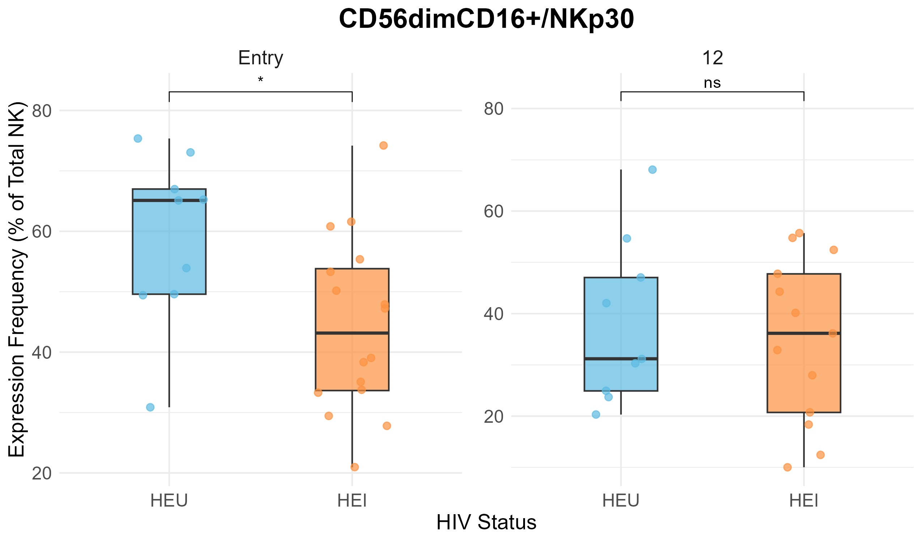
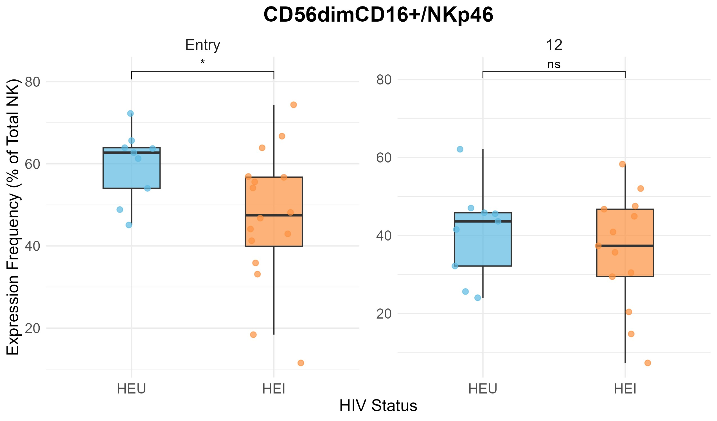
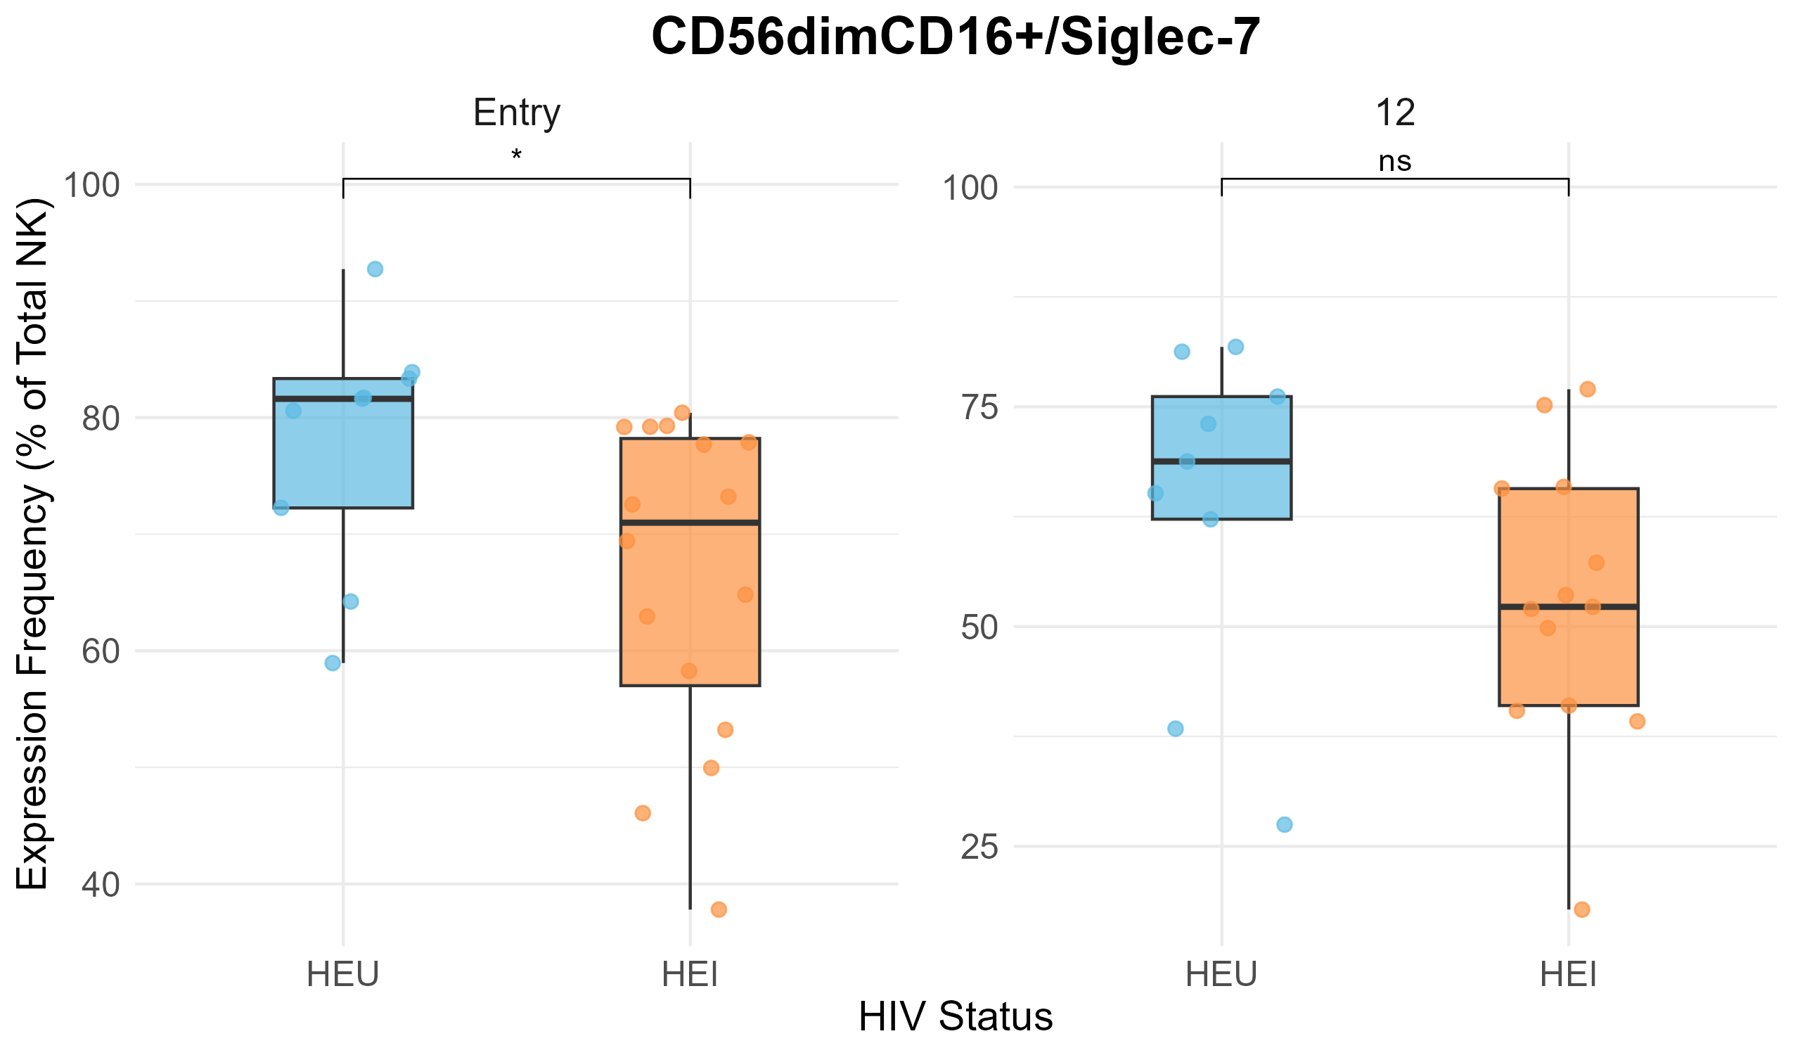
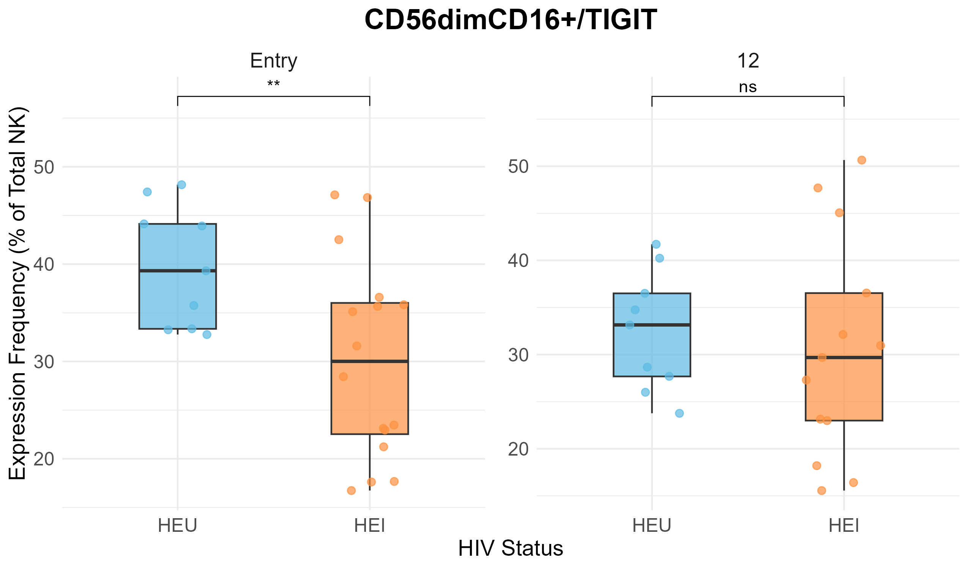
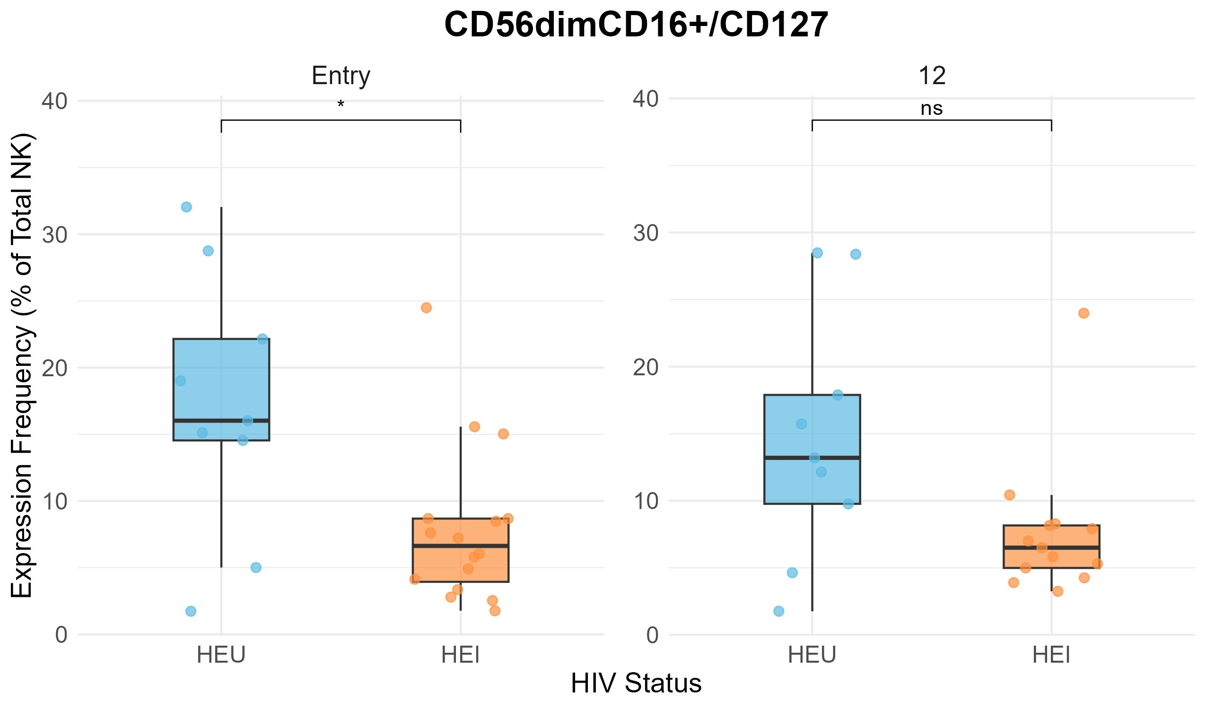
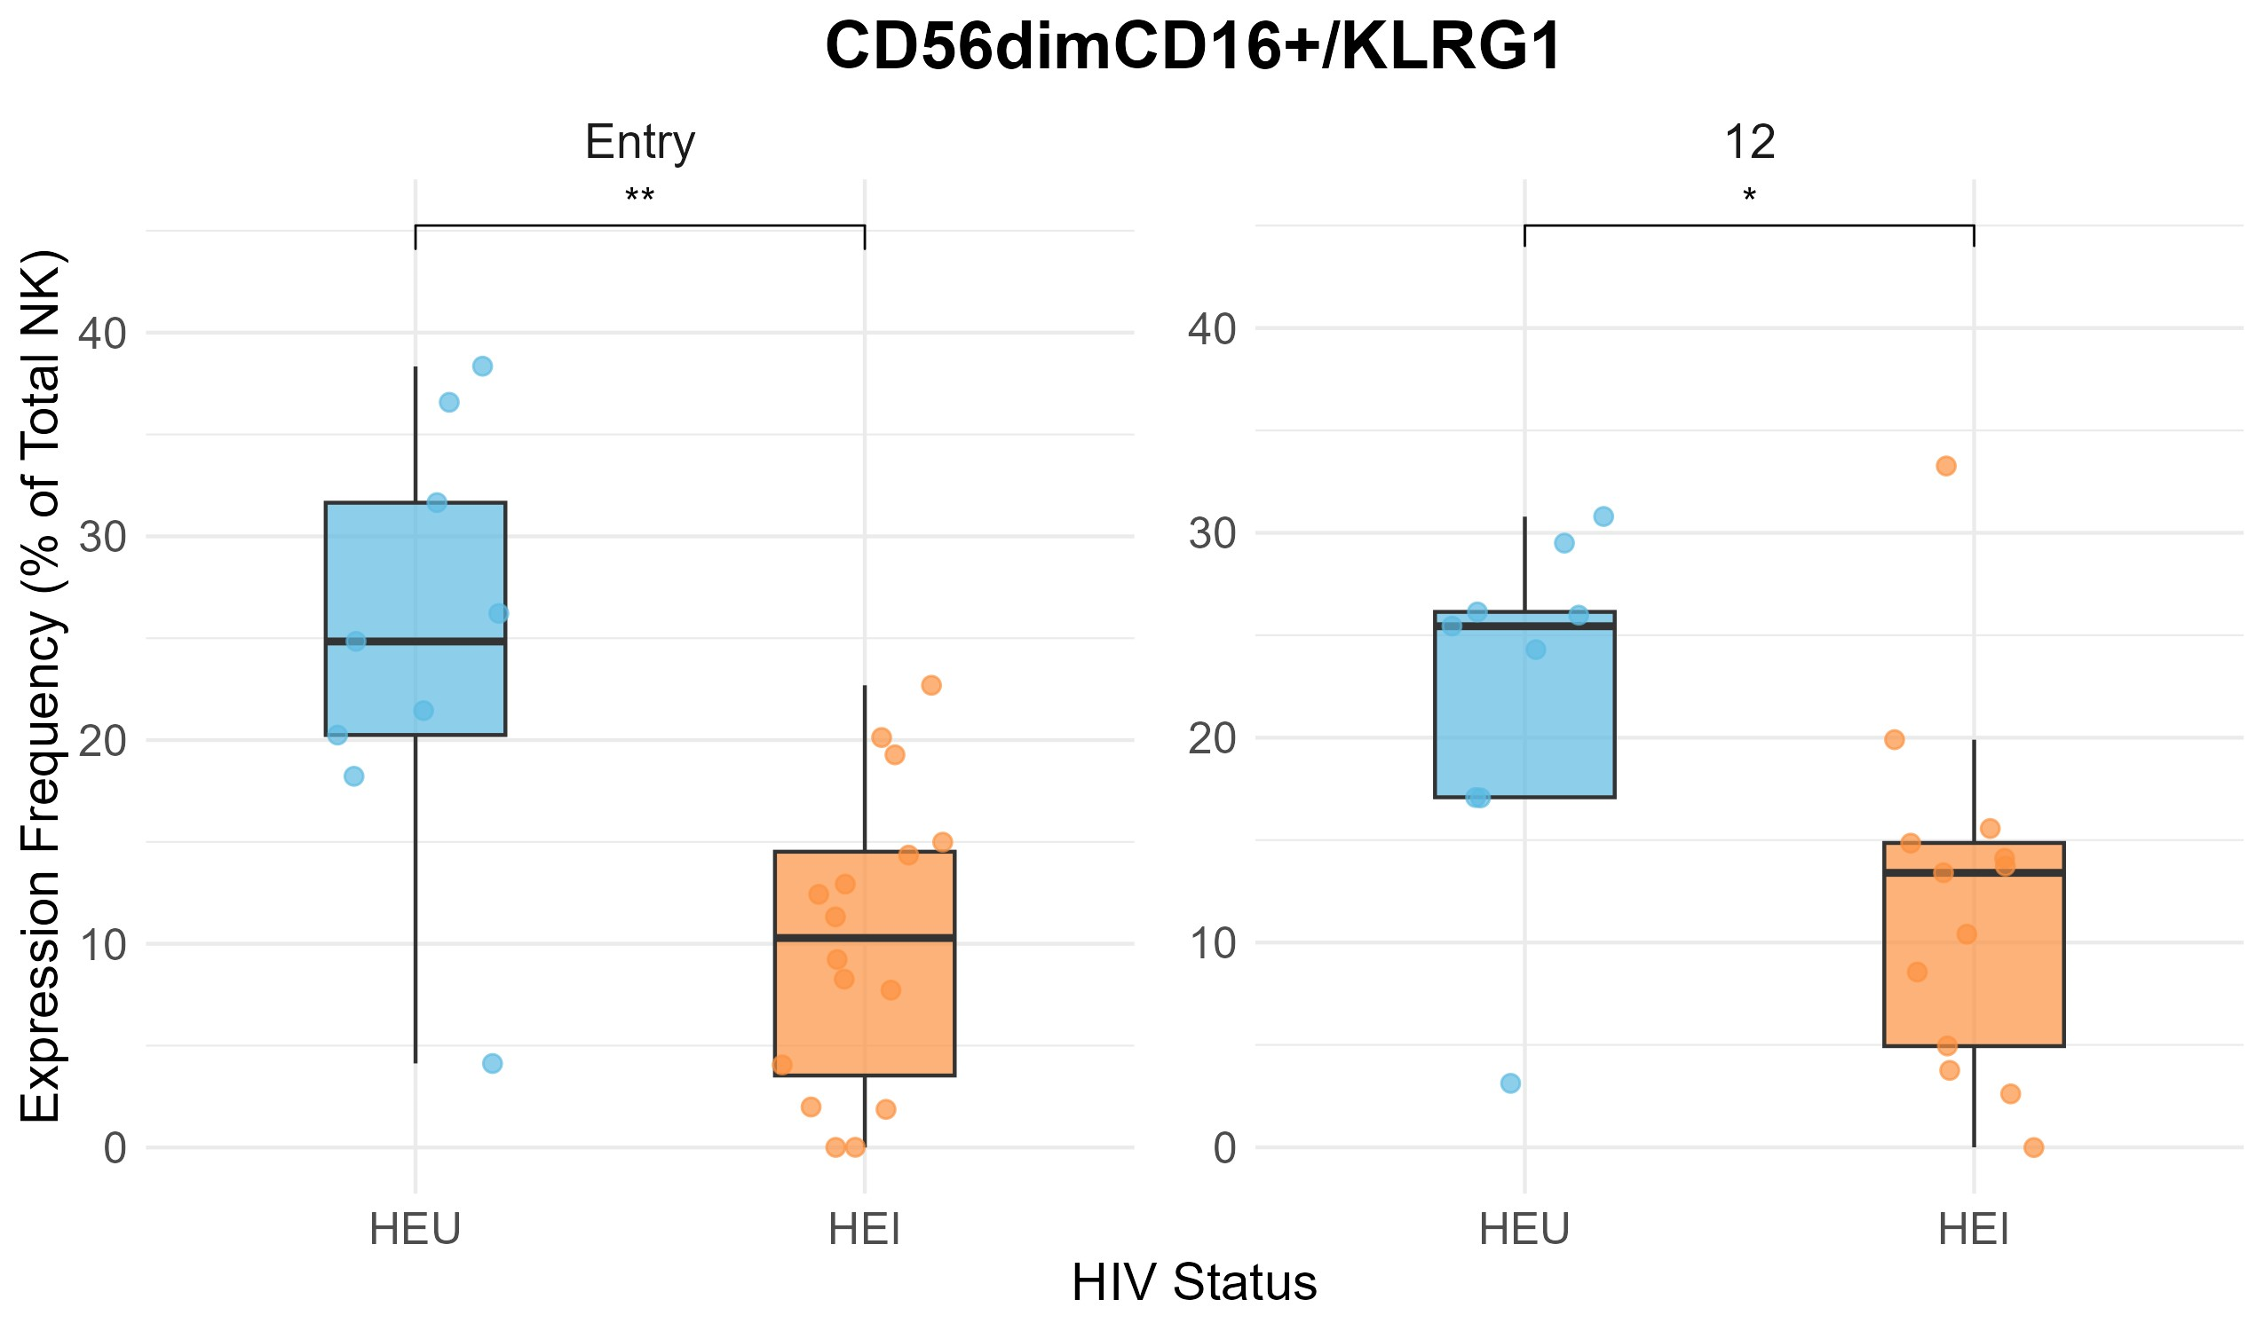
A
B
C
D
E
F
Notes:
Figure 4

Slide 7
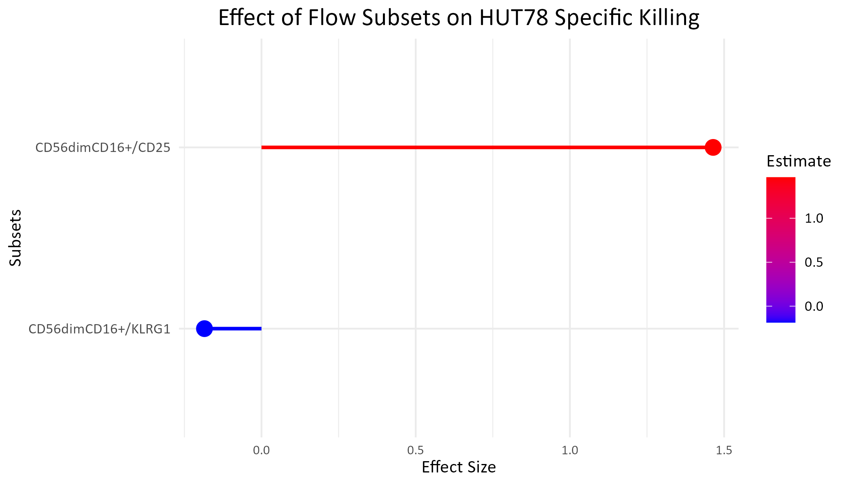
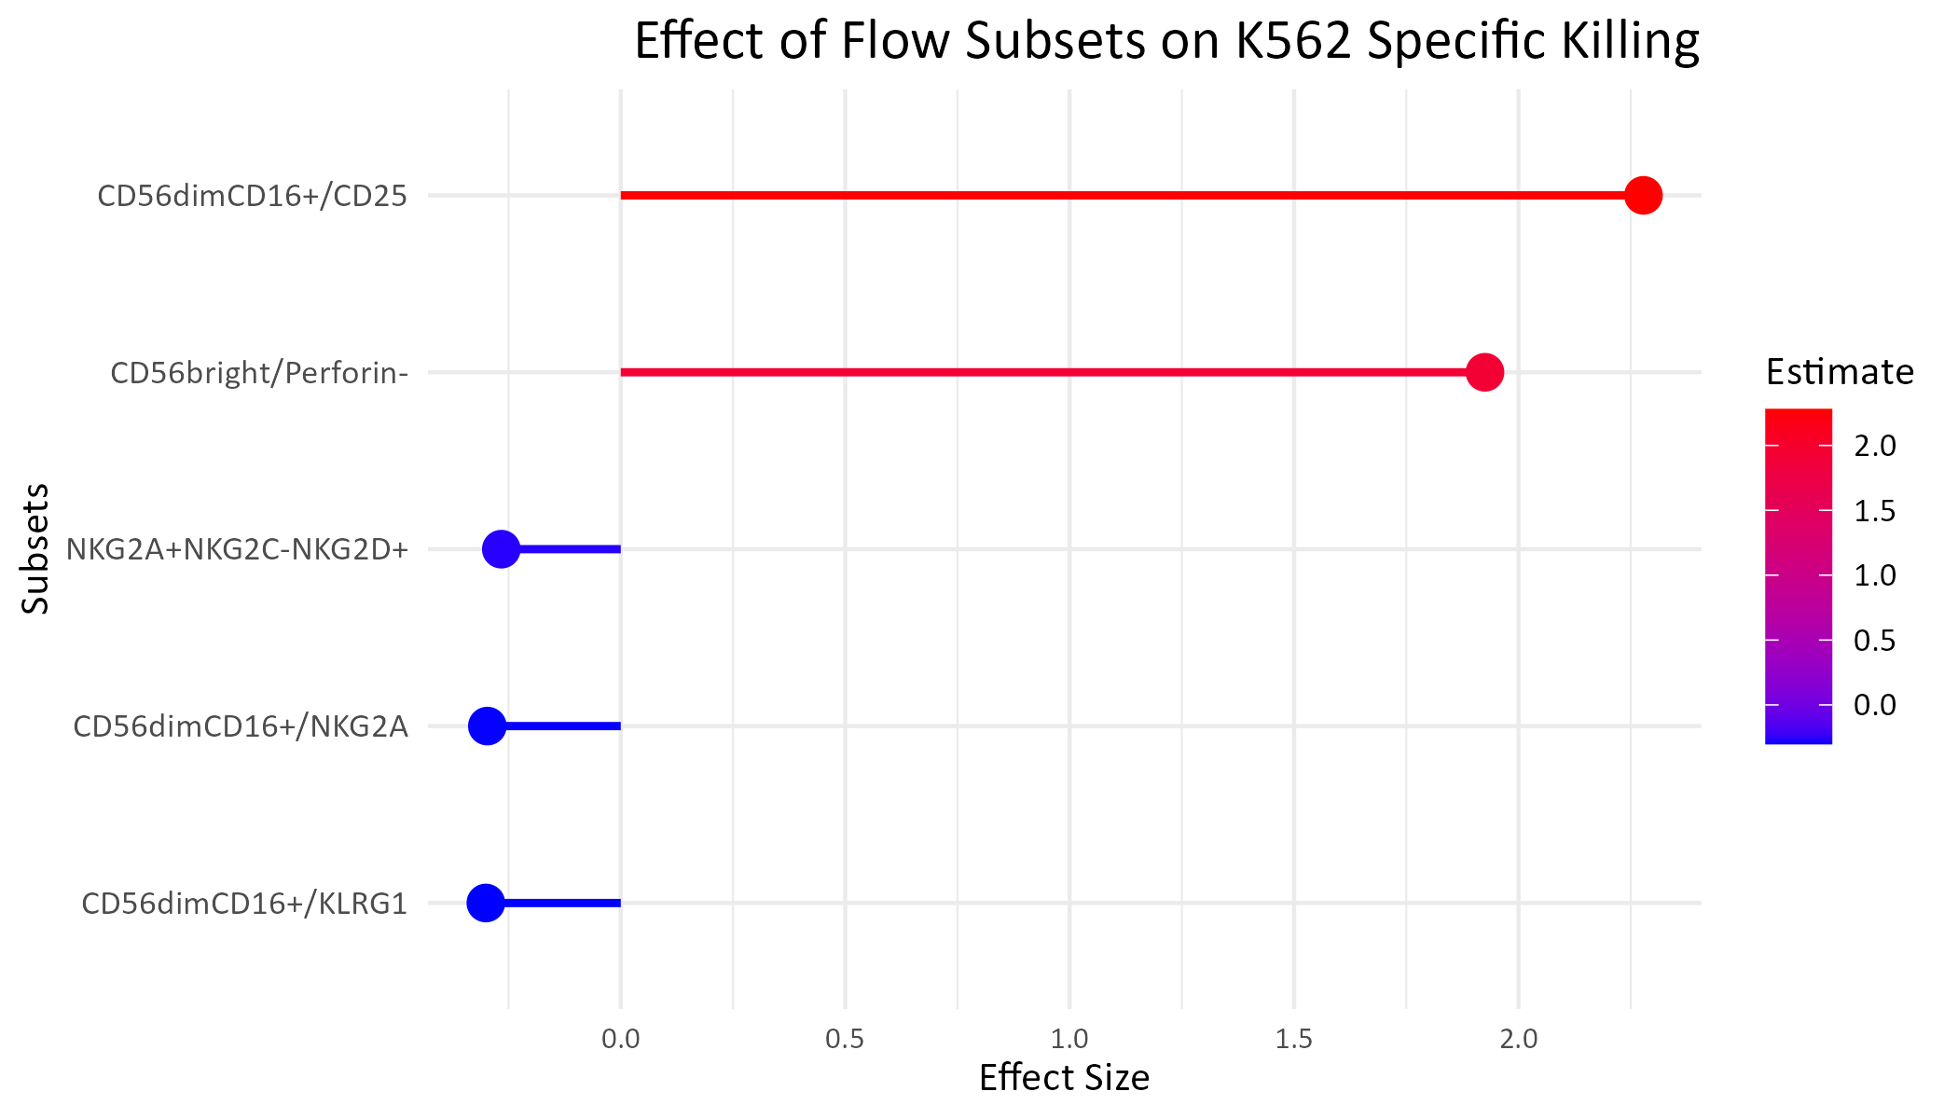
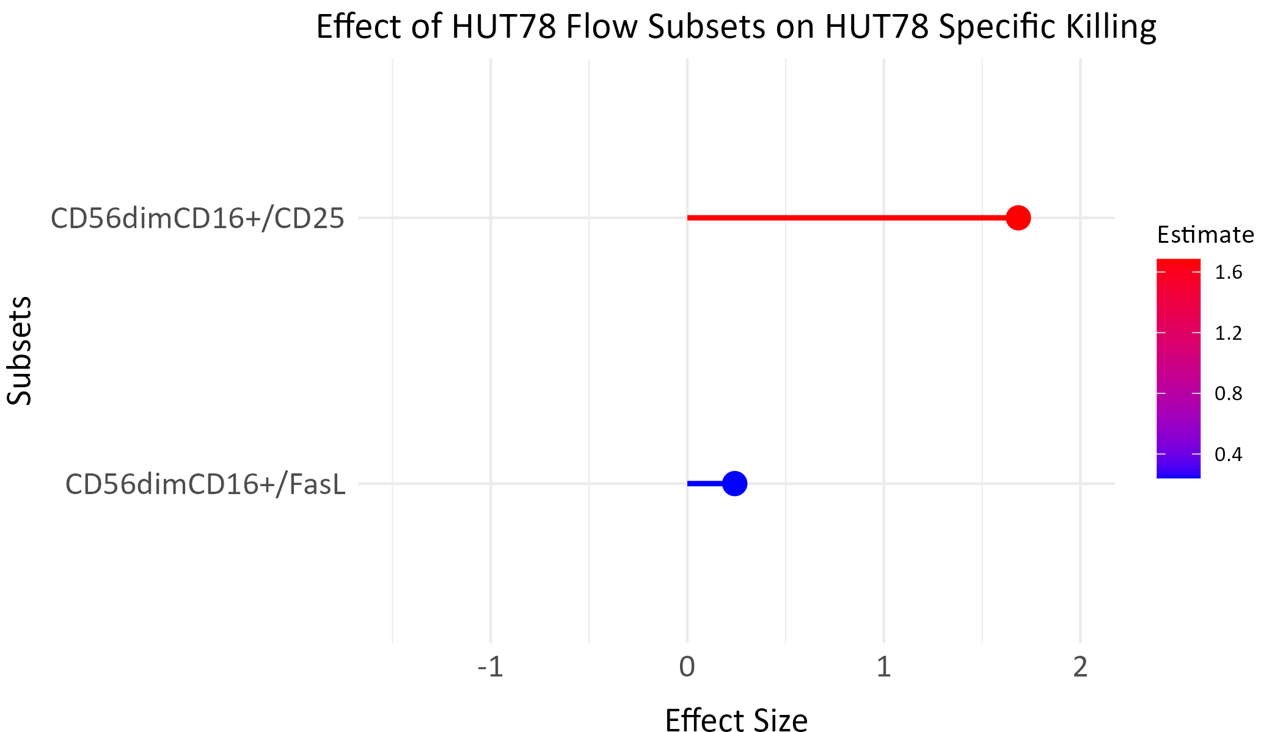
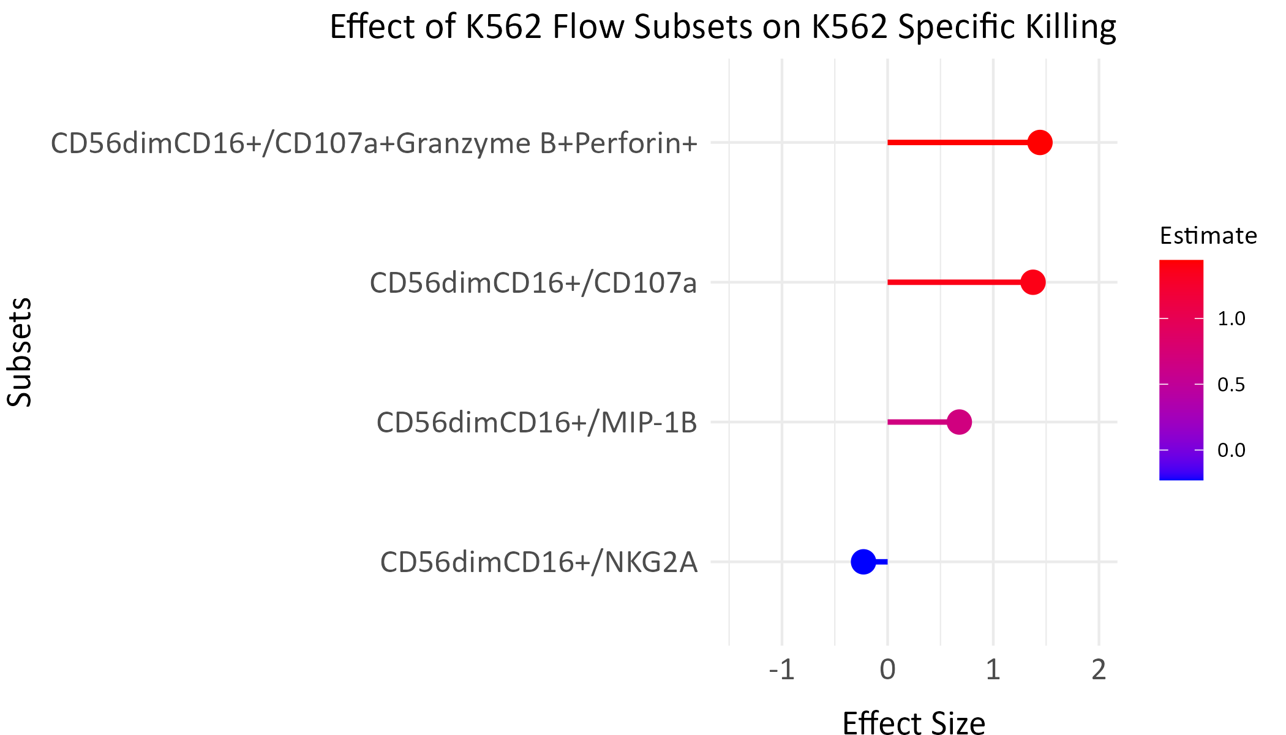
A
B
C
D
Notes:
Figure 5

Slide 8
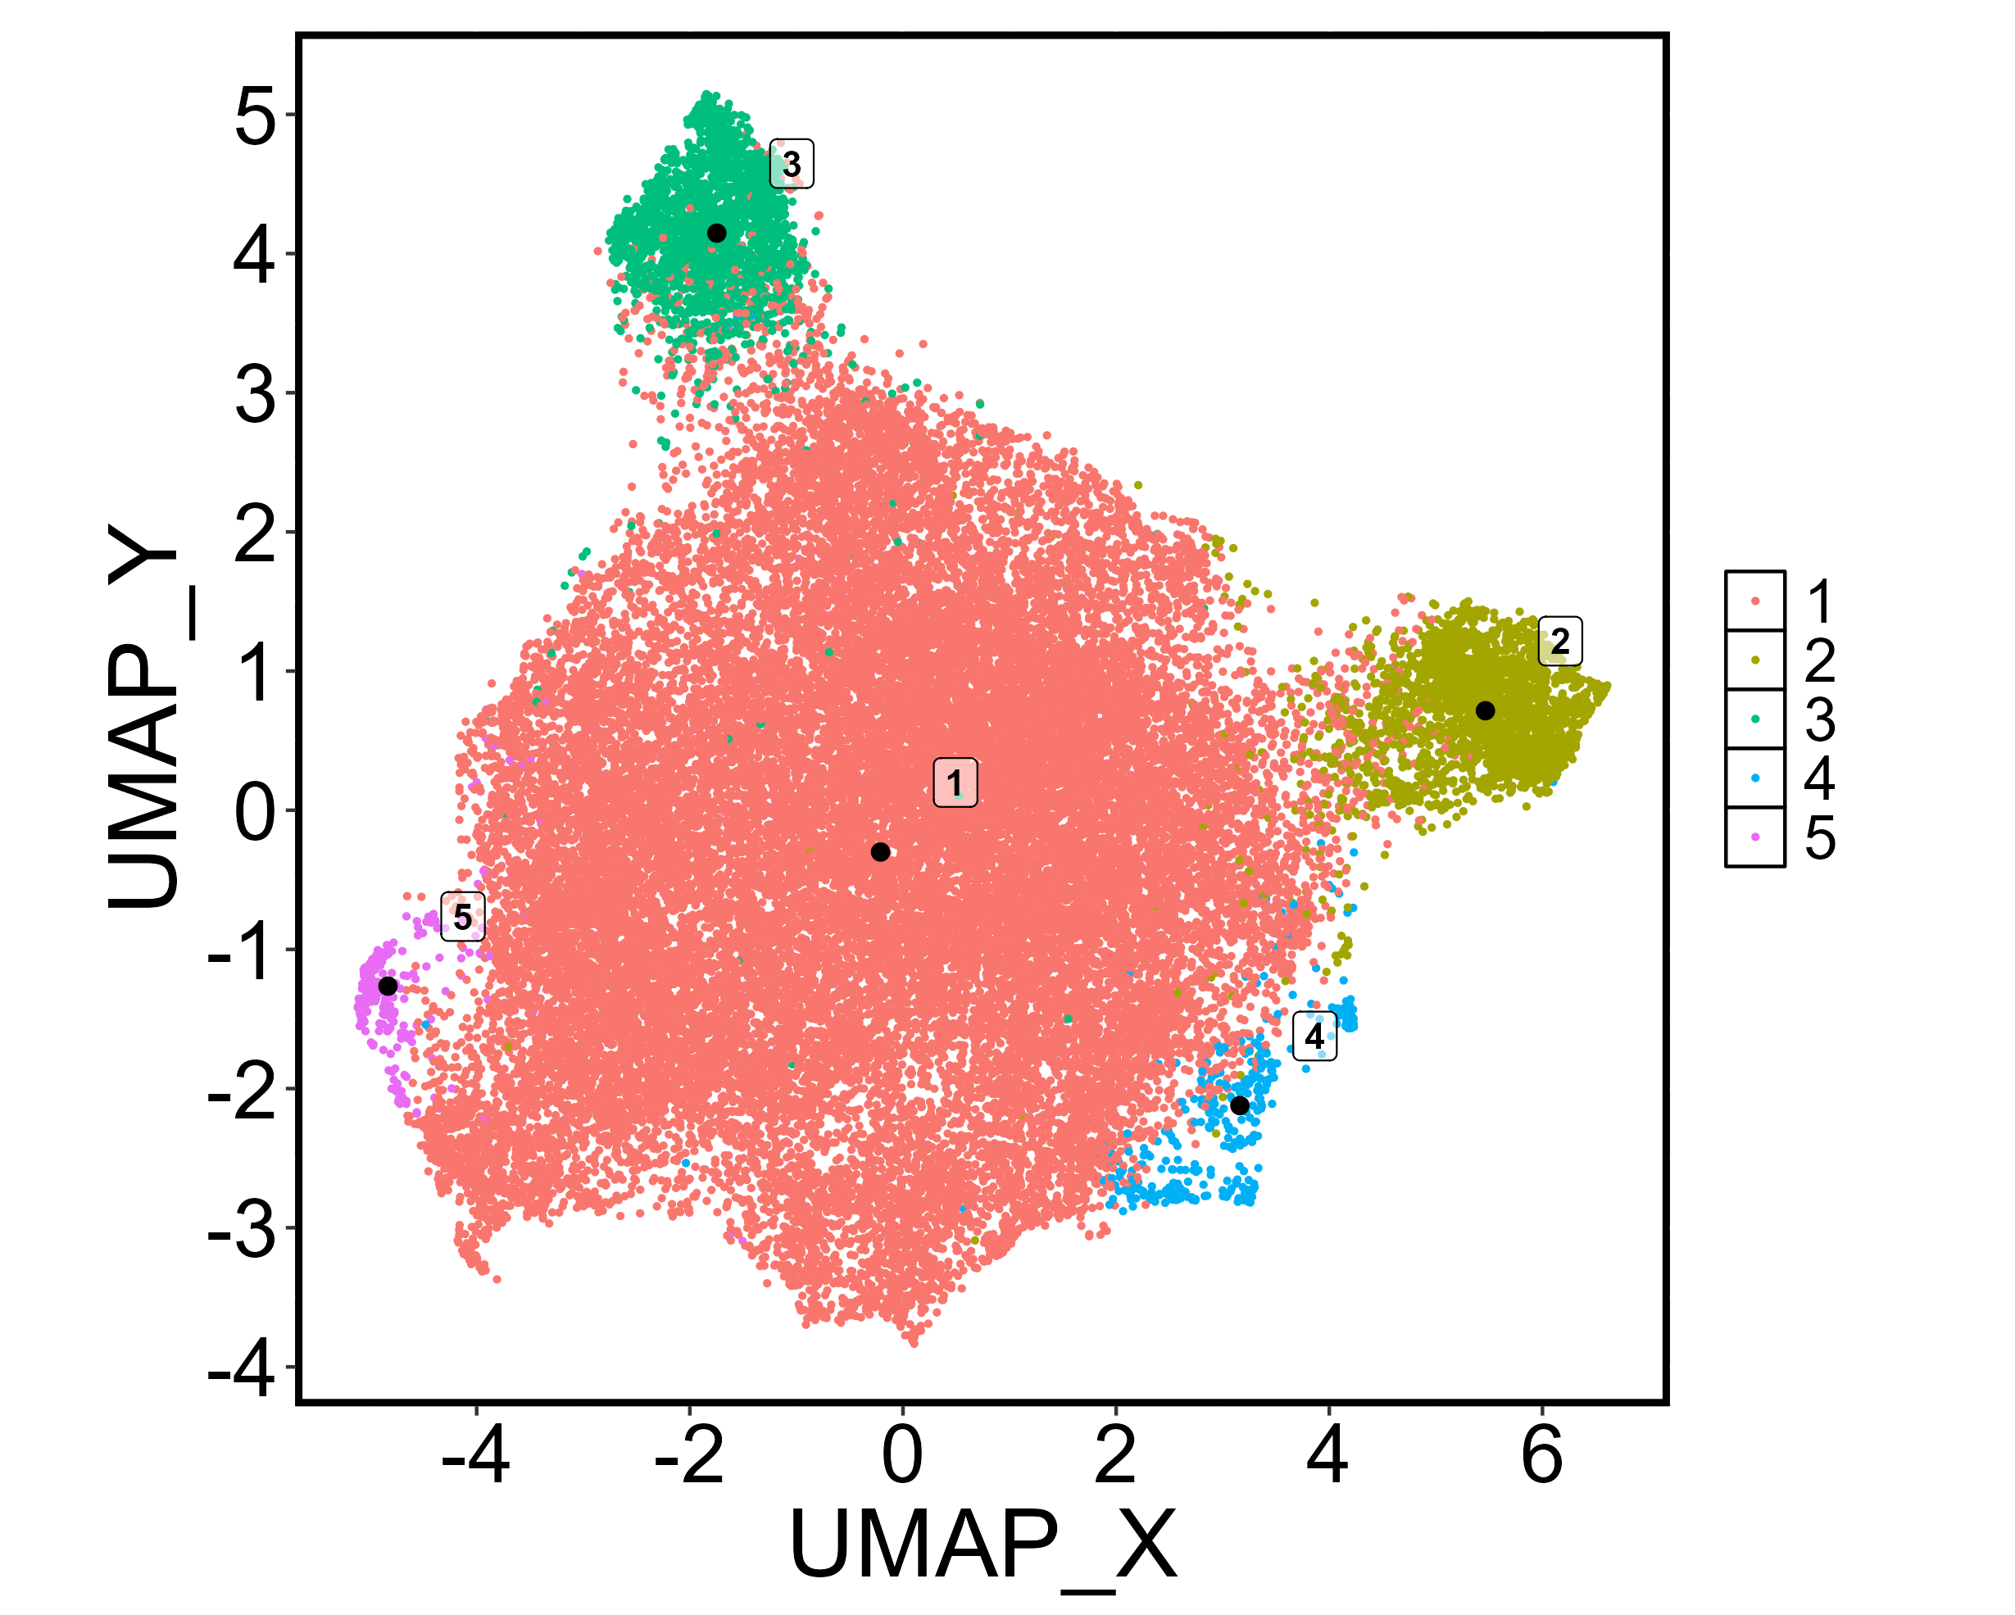
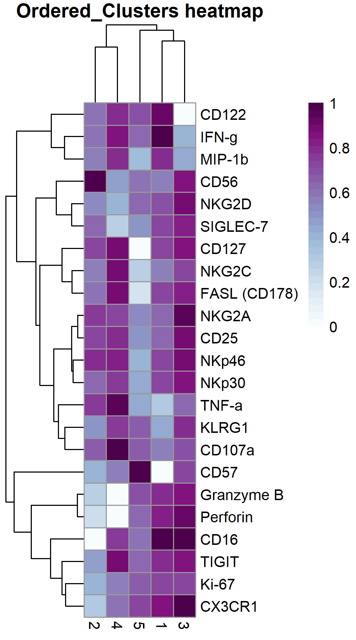
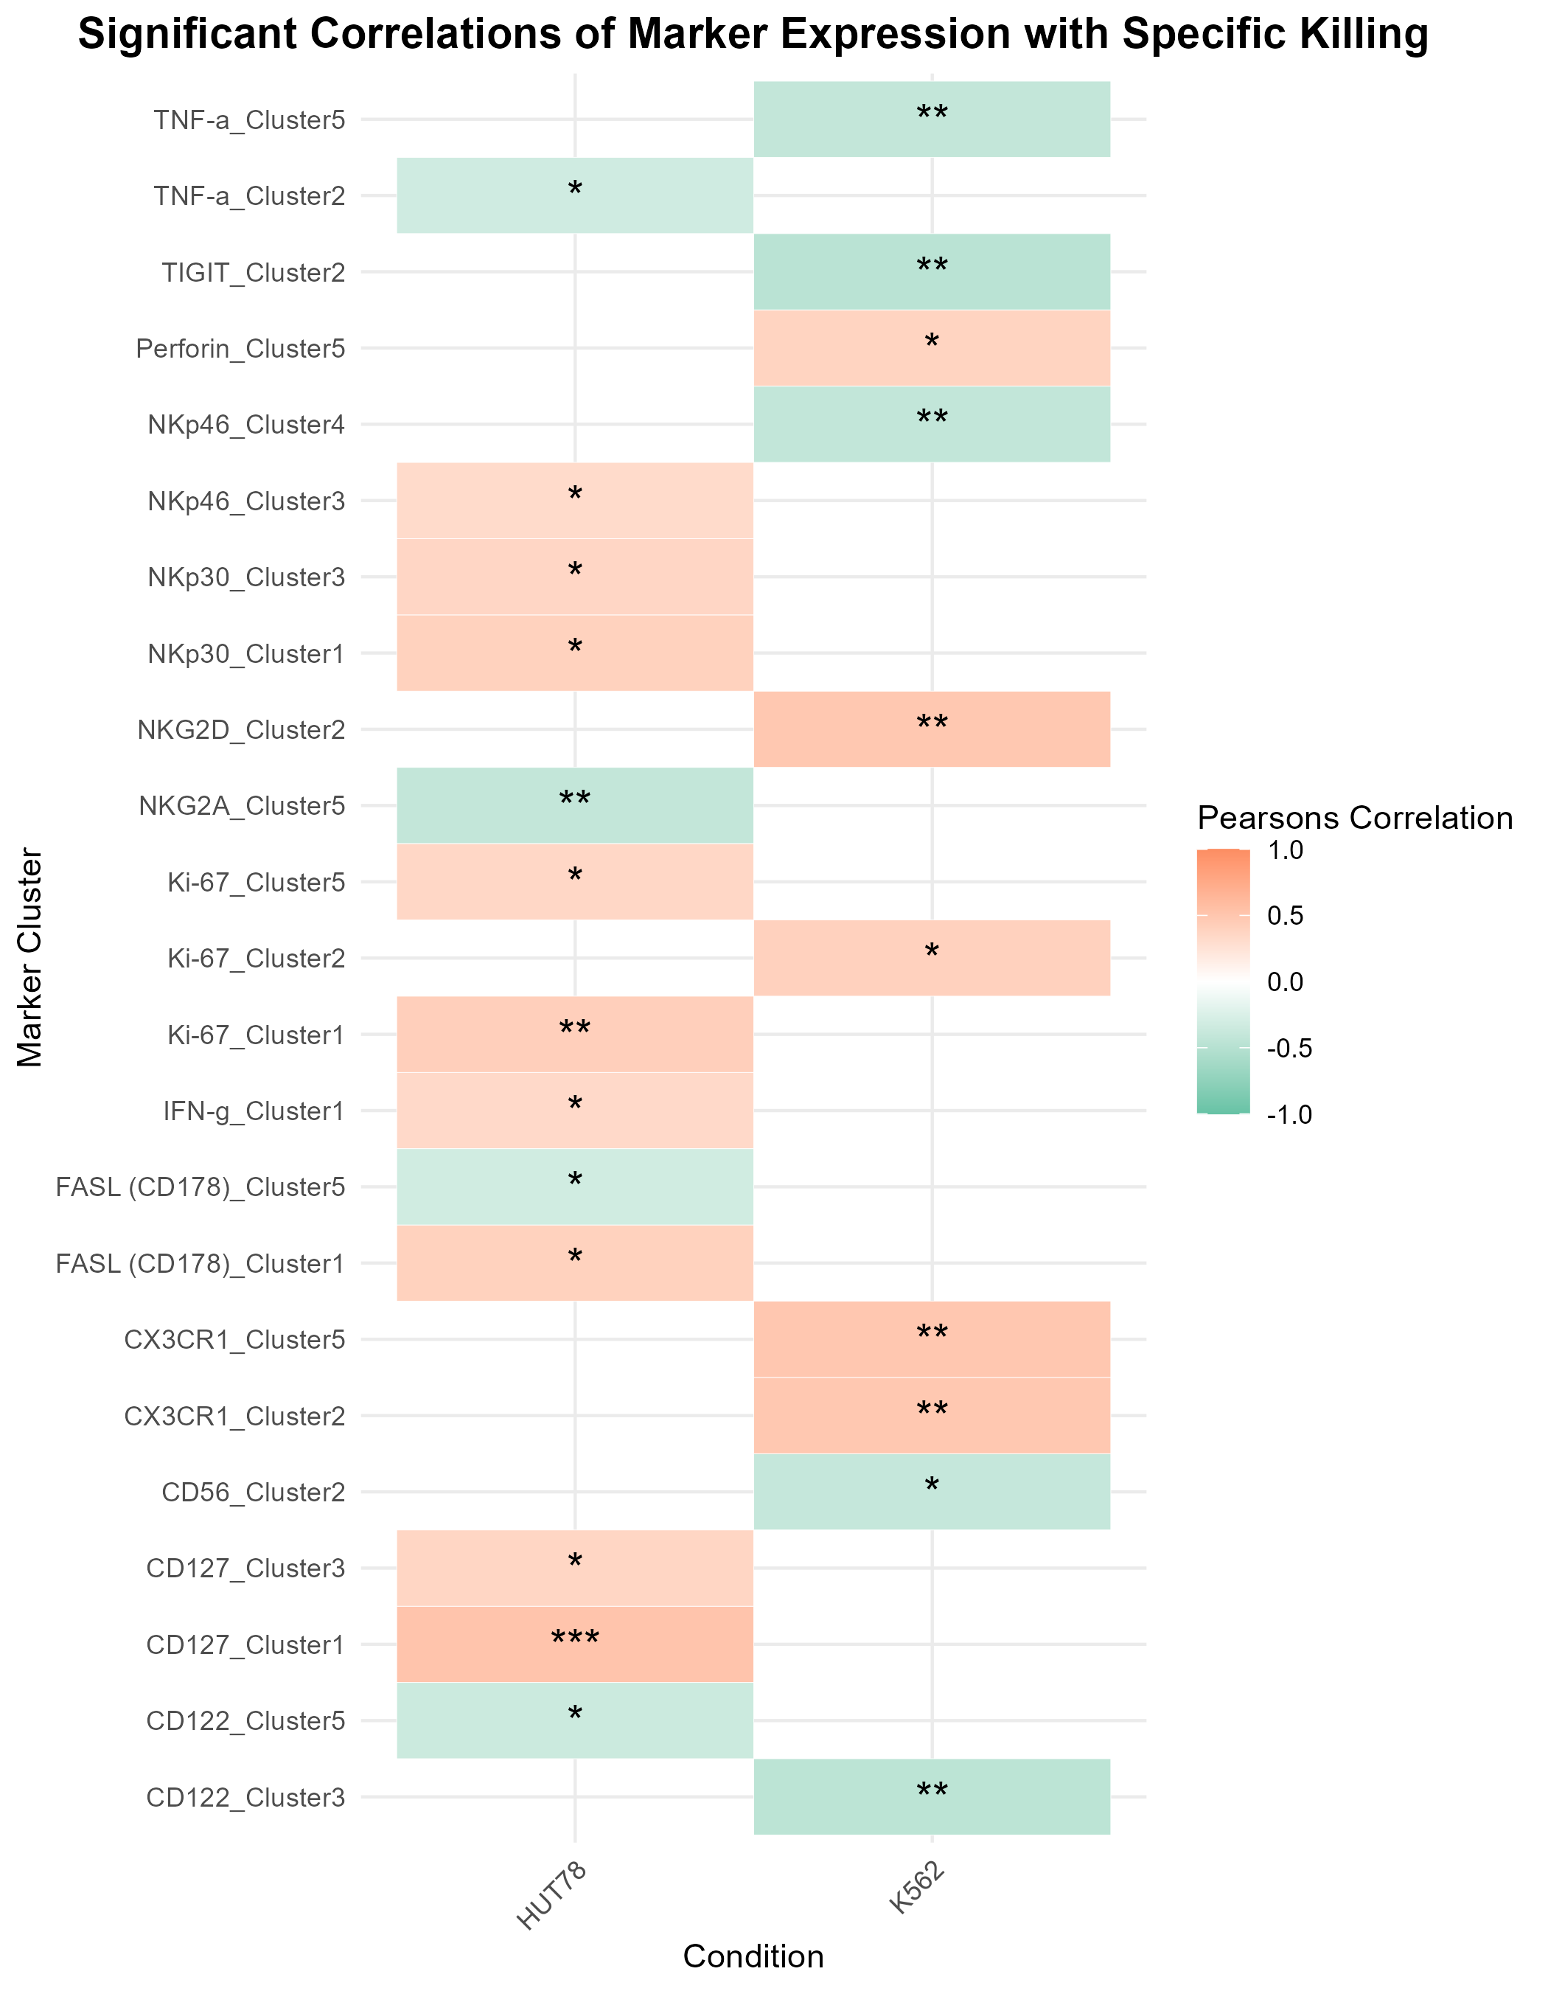
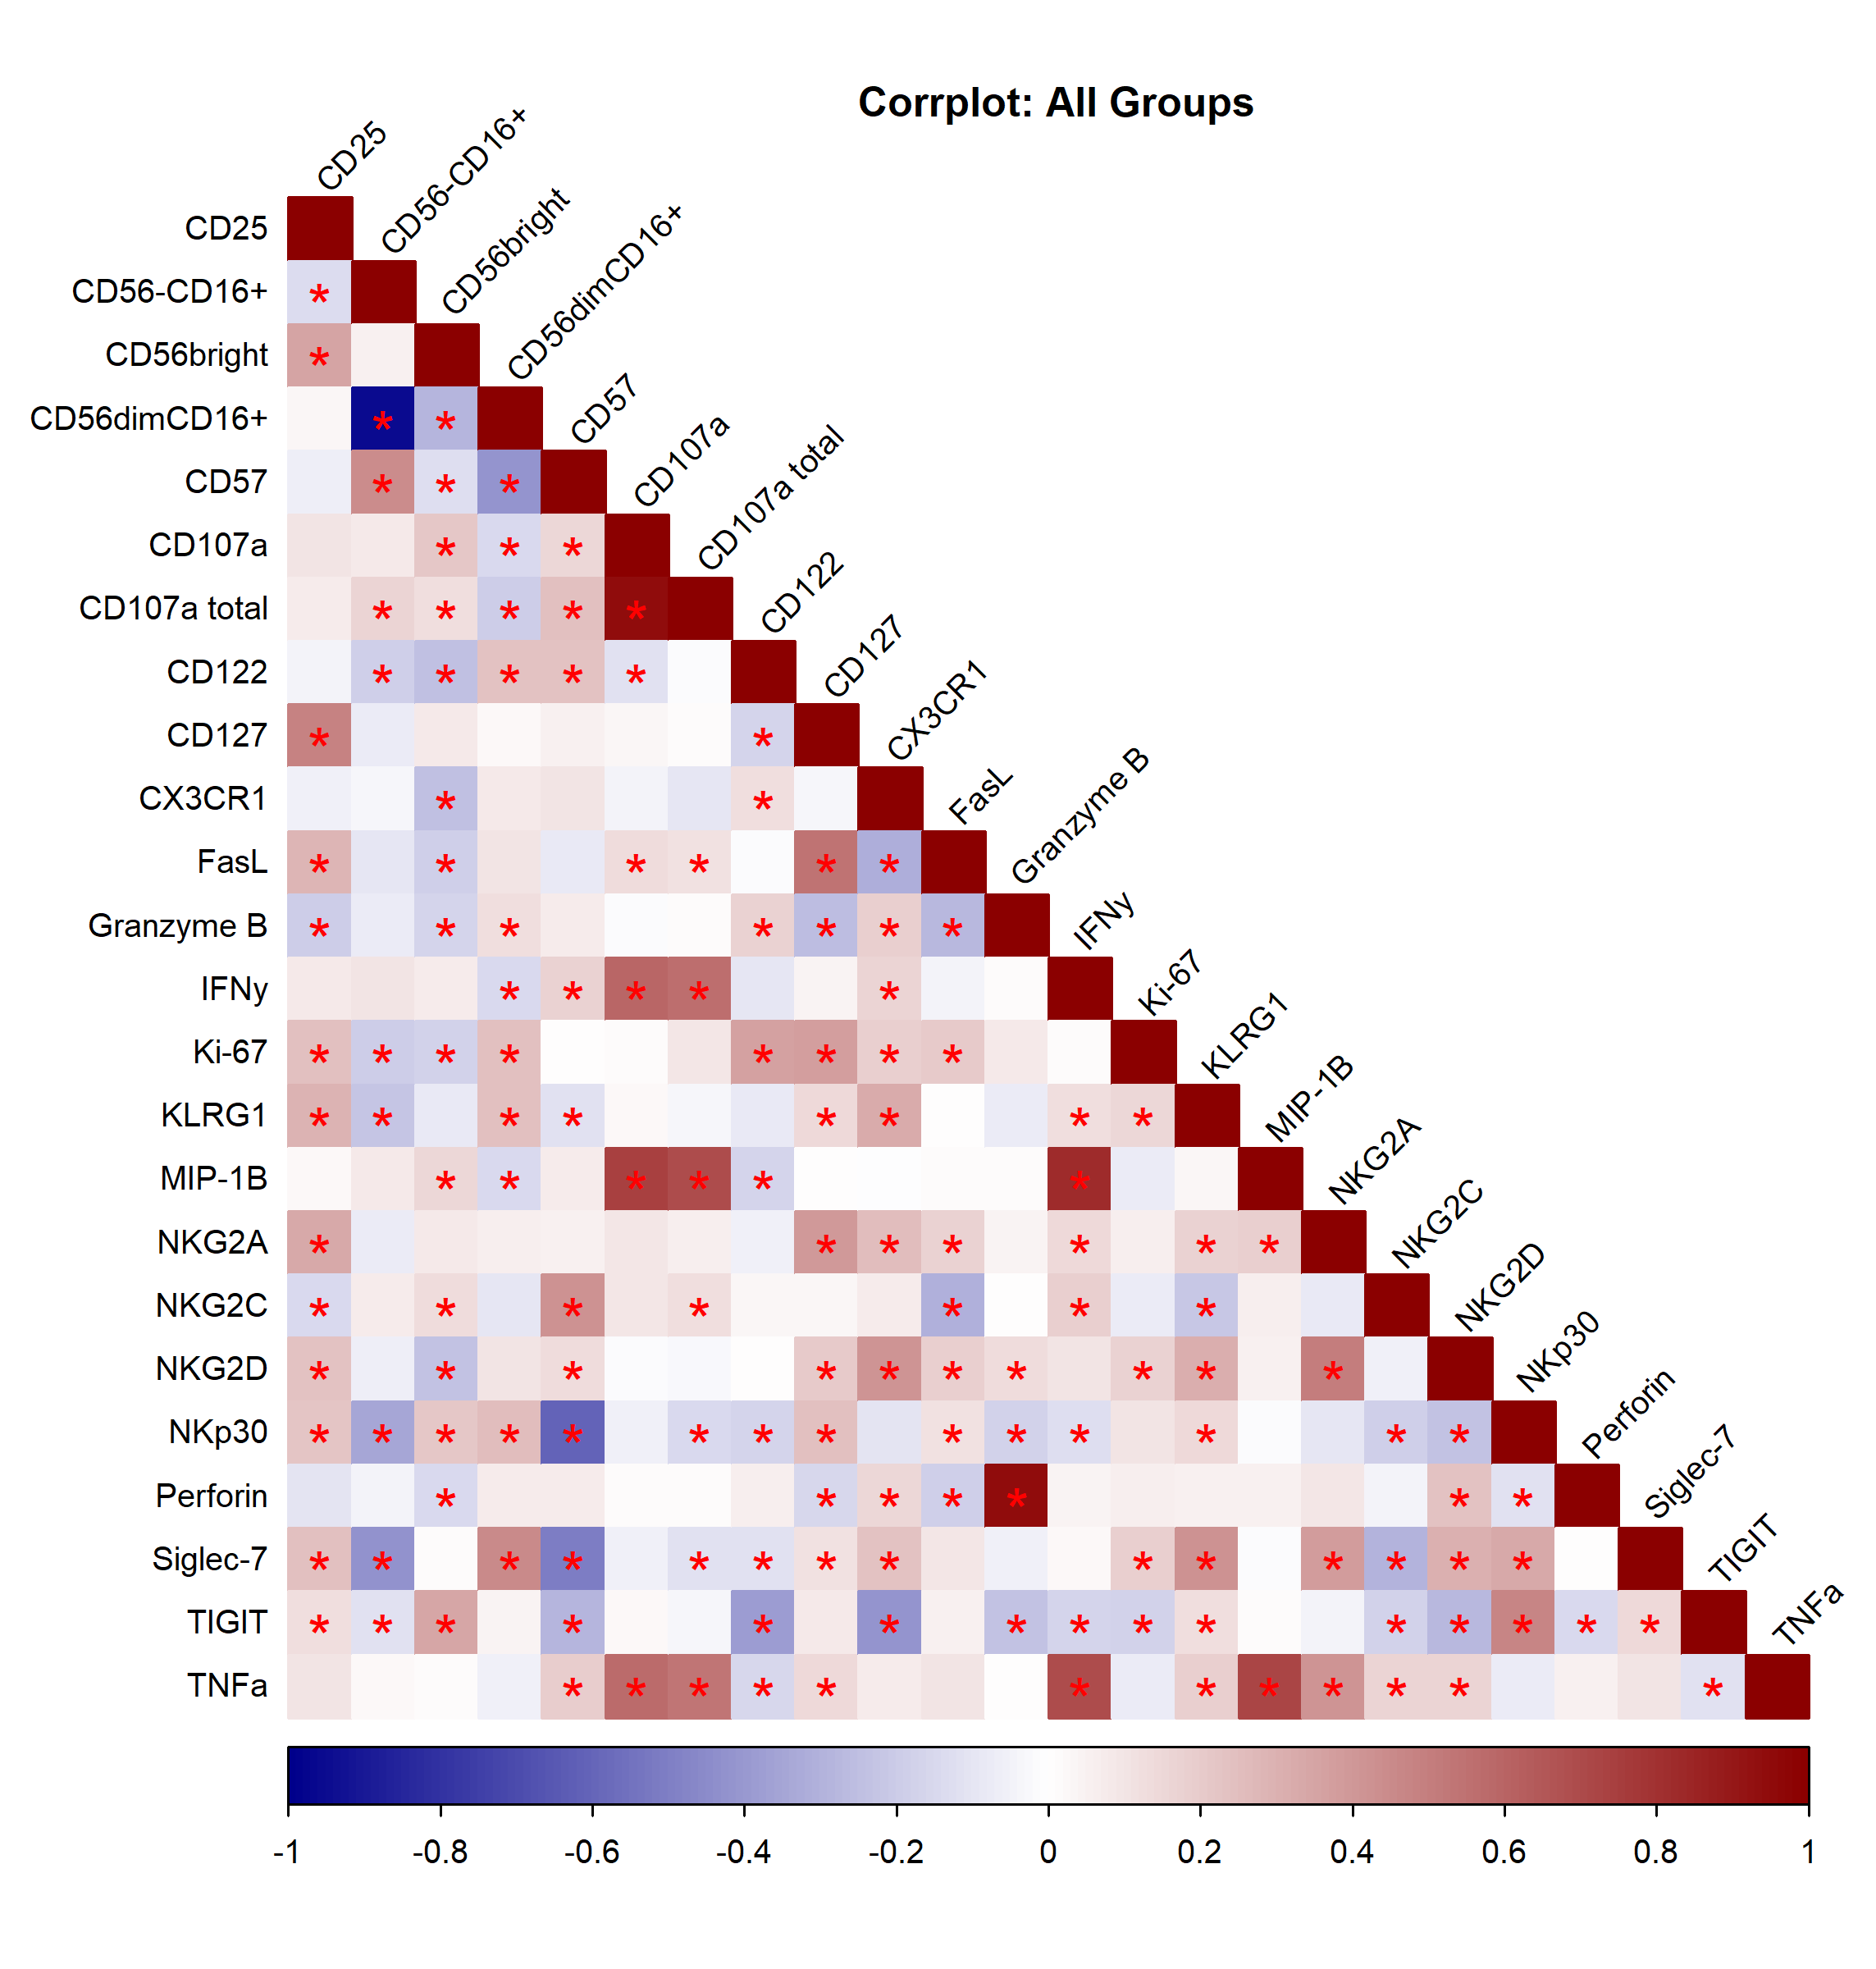
A
B
C
D
Notes:
Figure 6

Slide 9
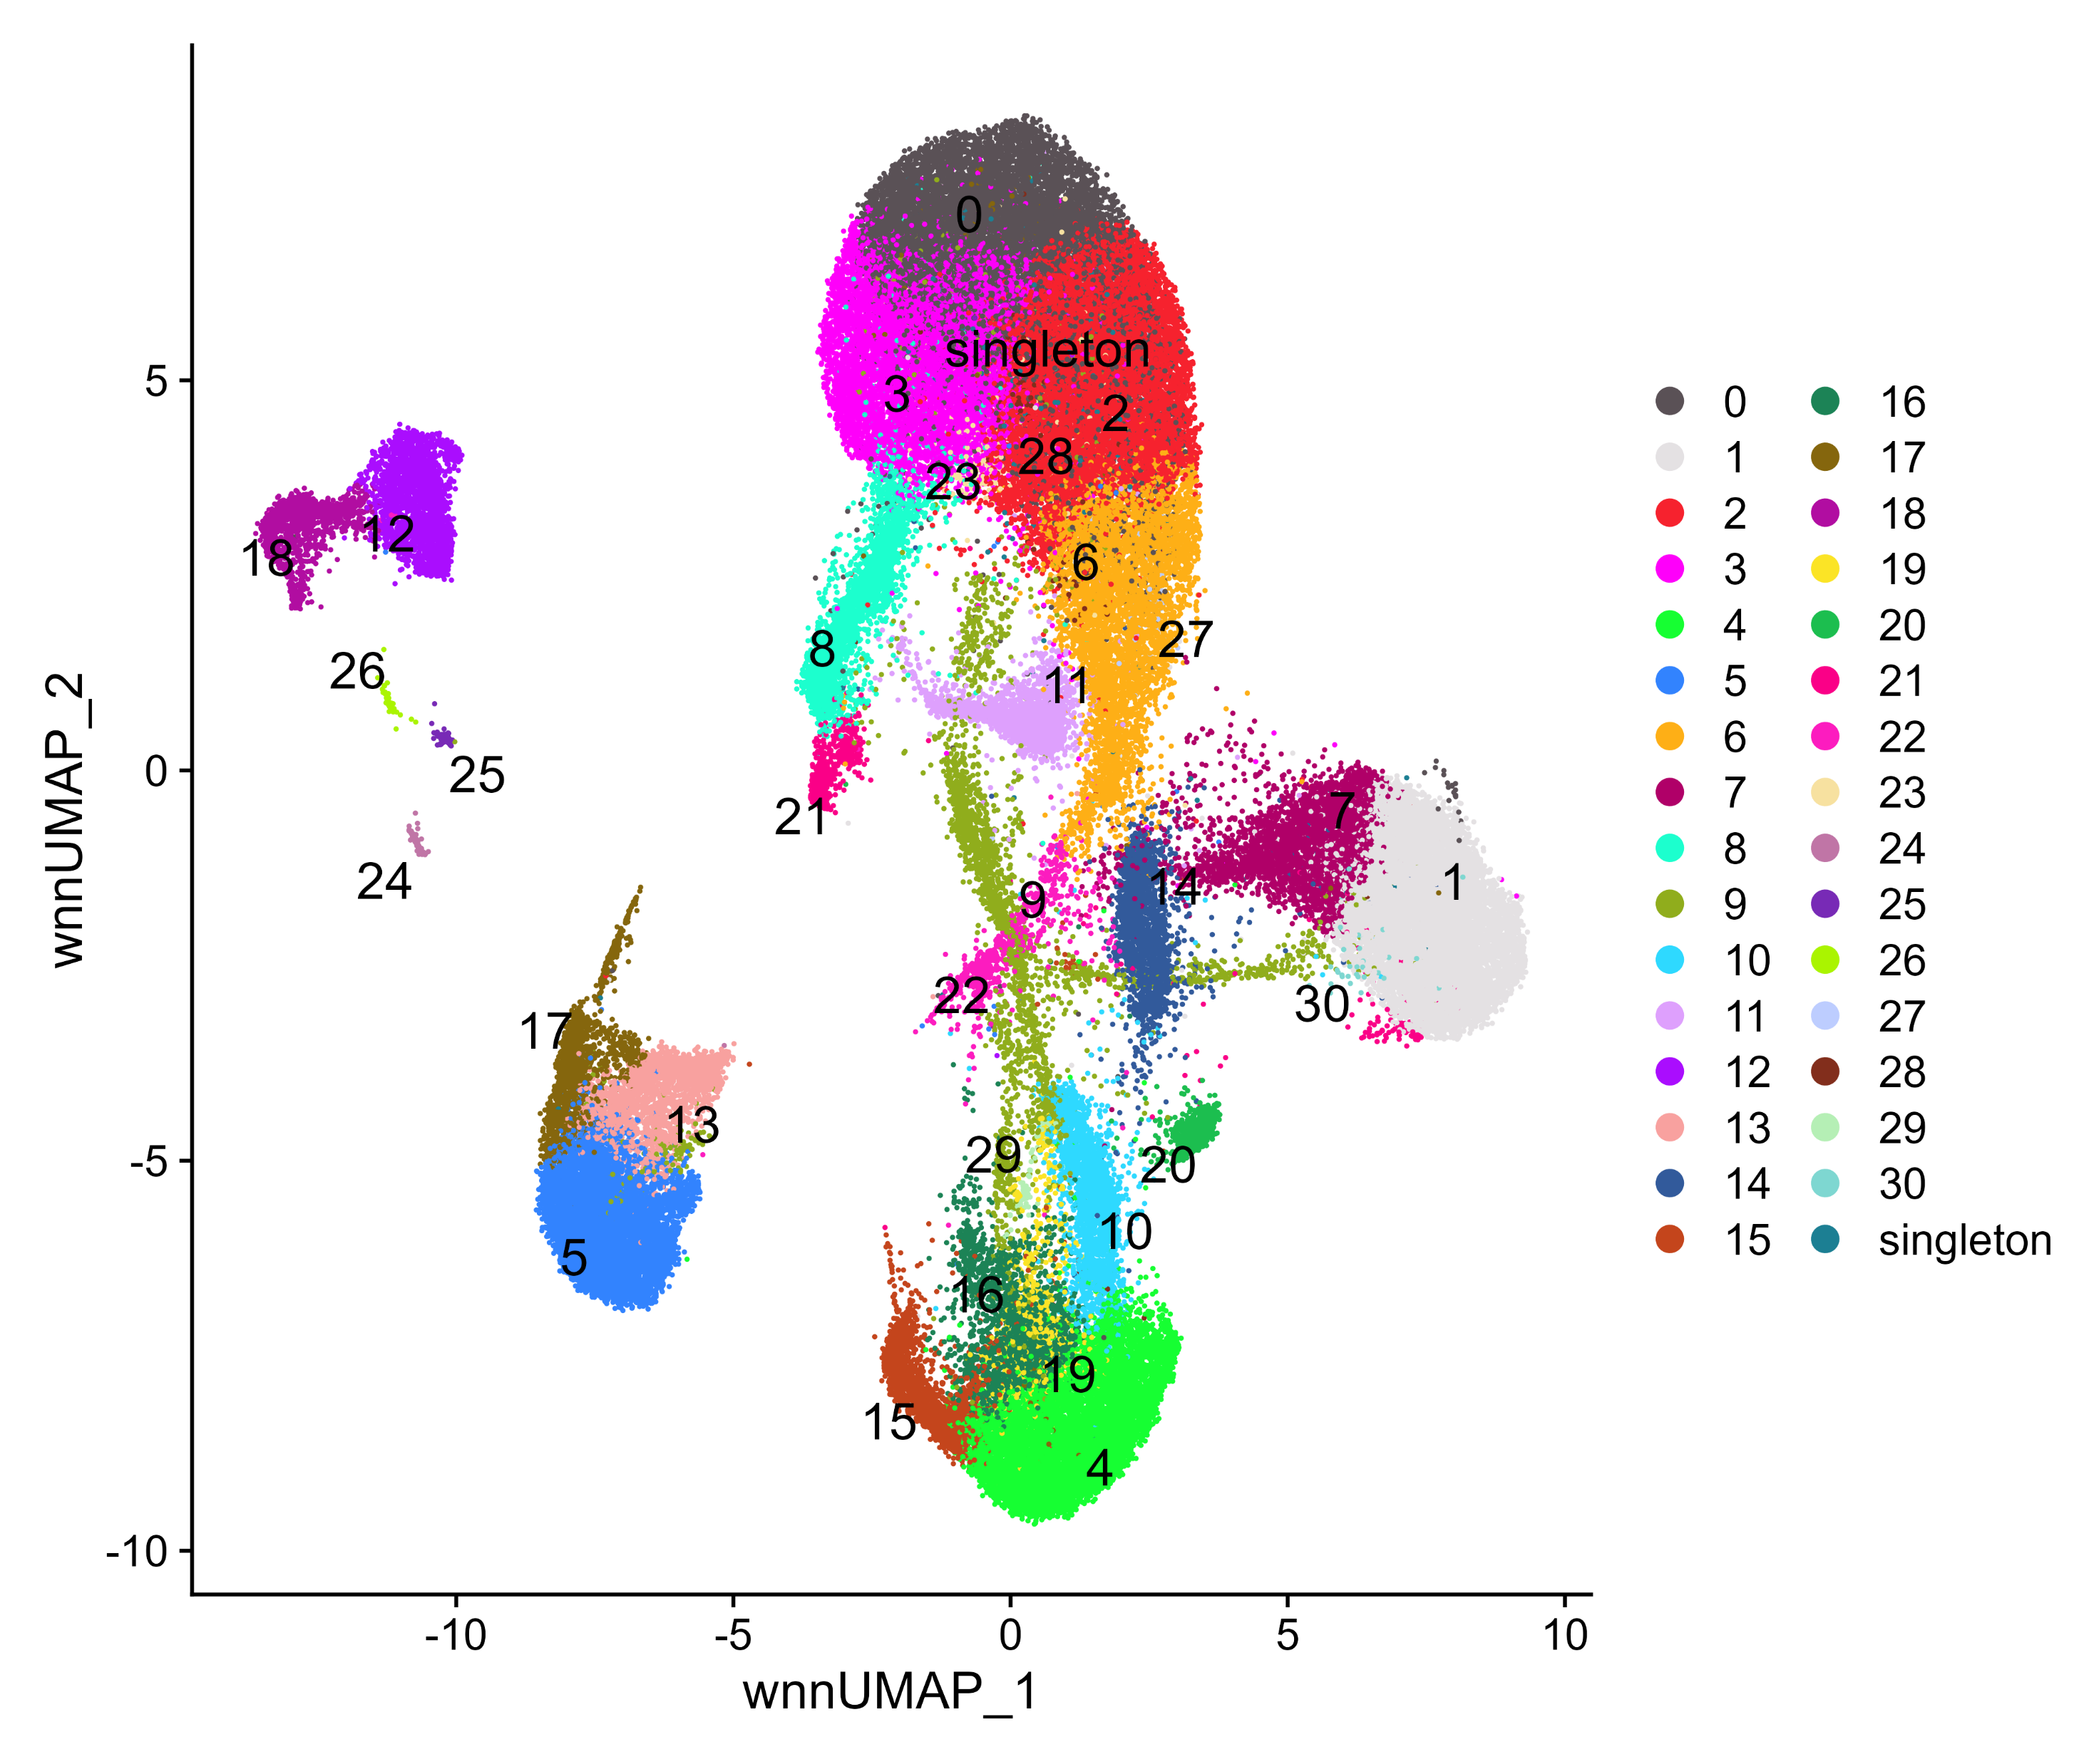
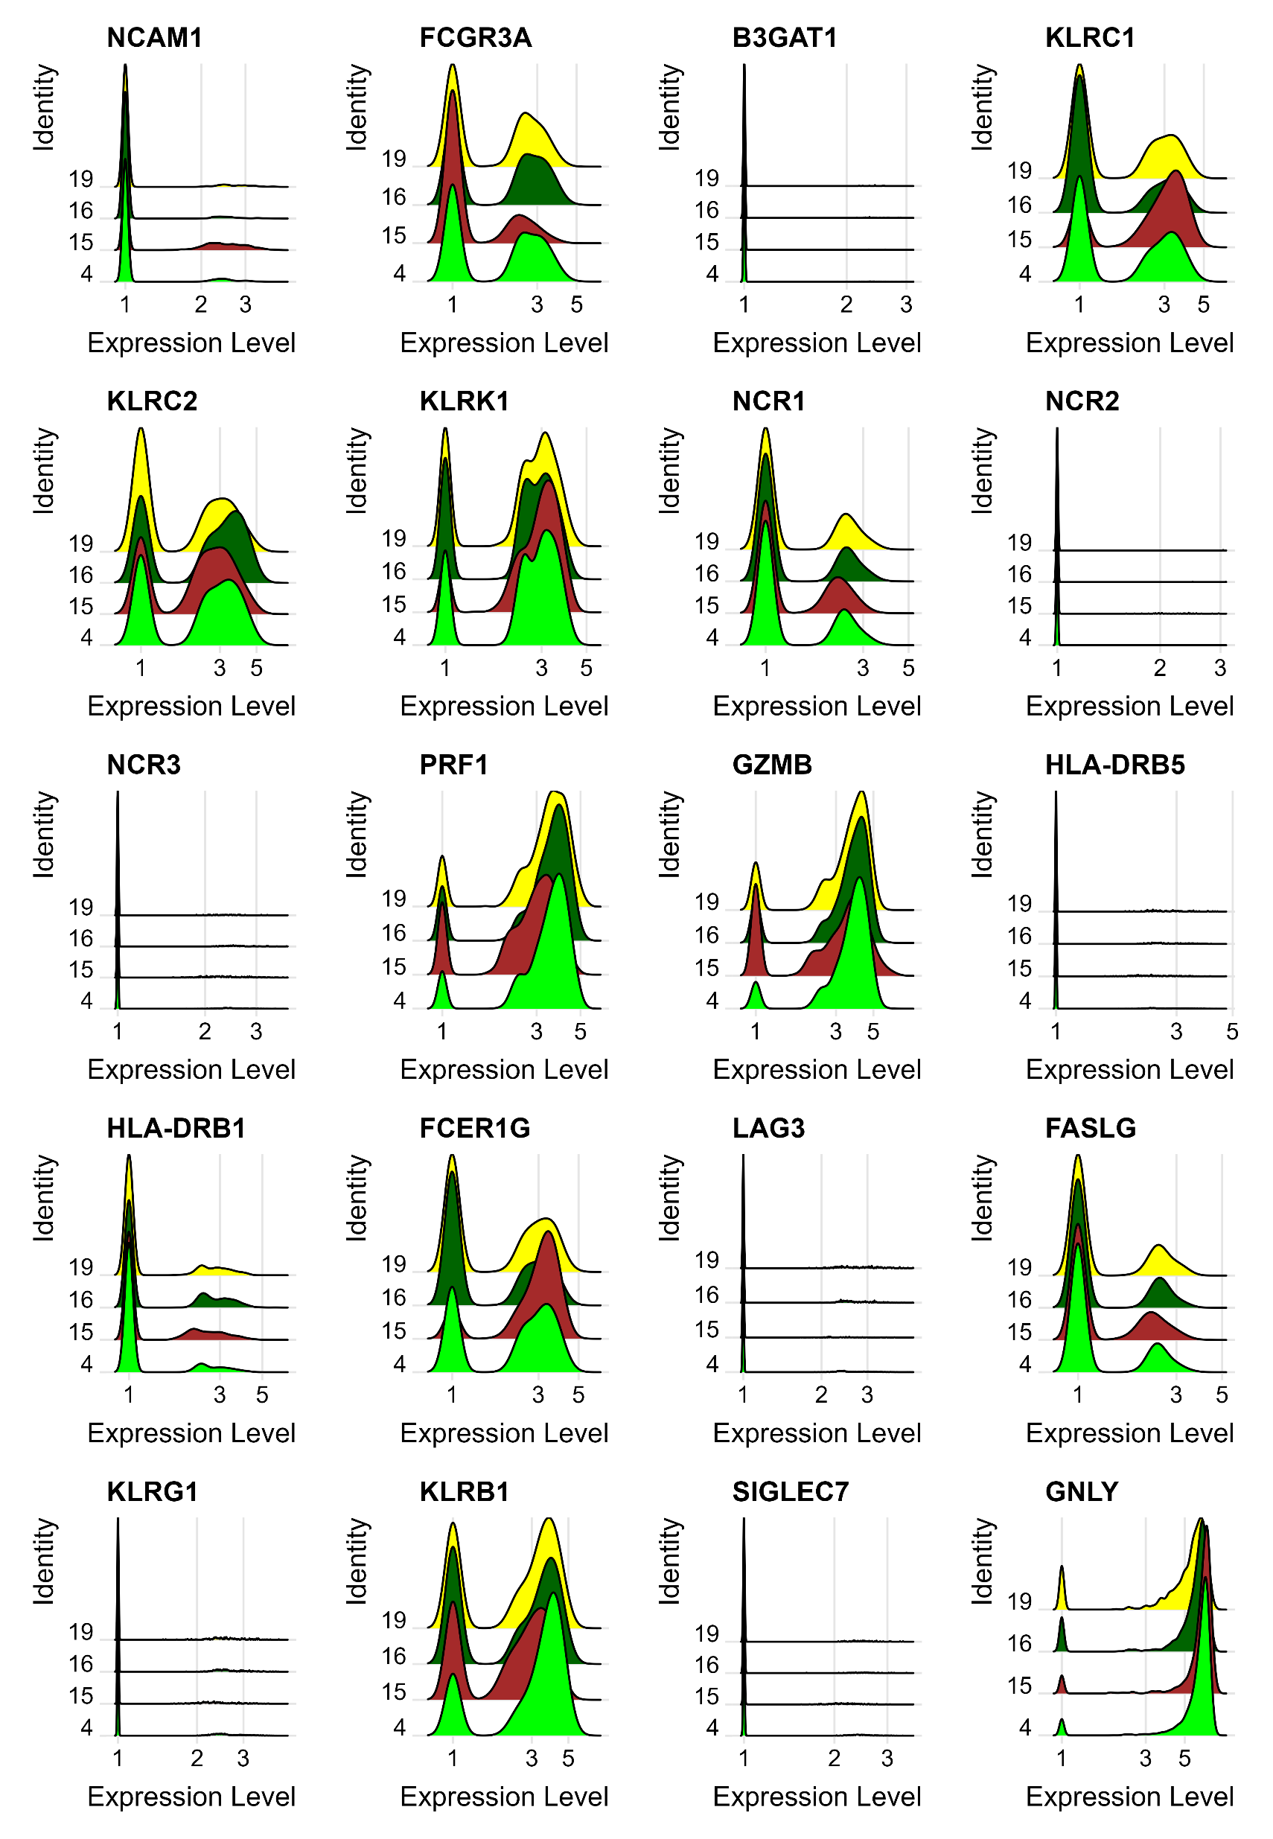
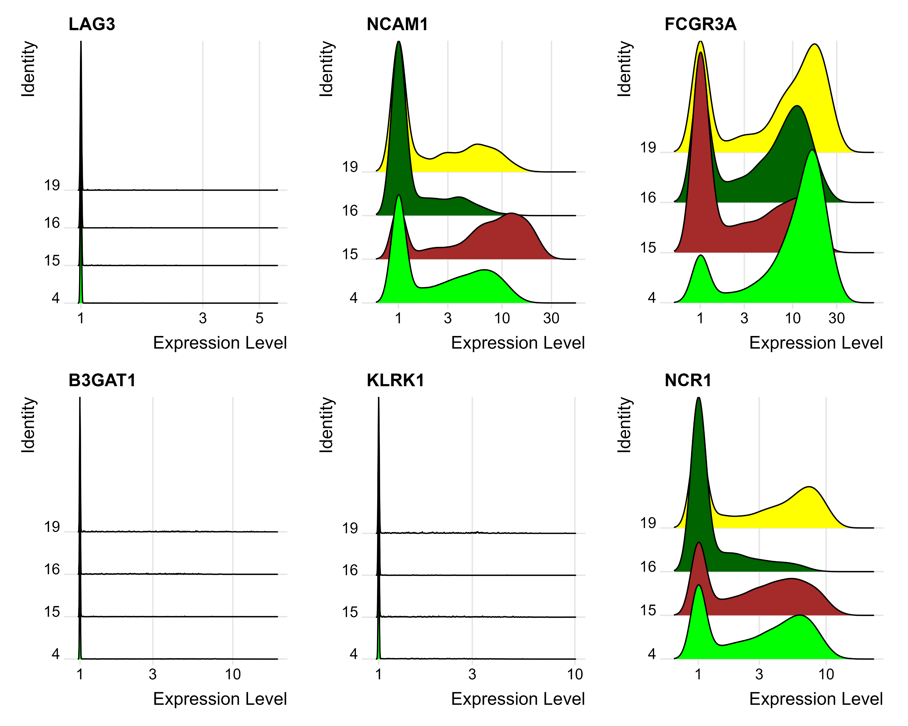
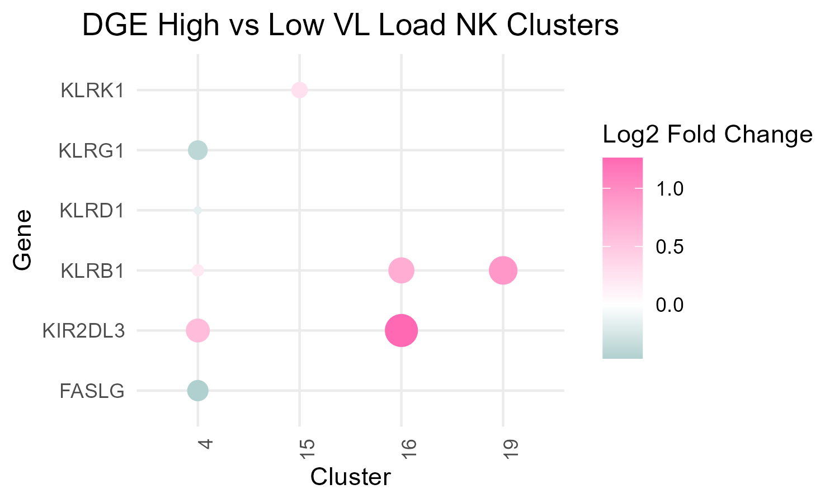
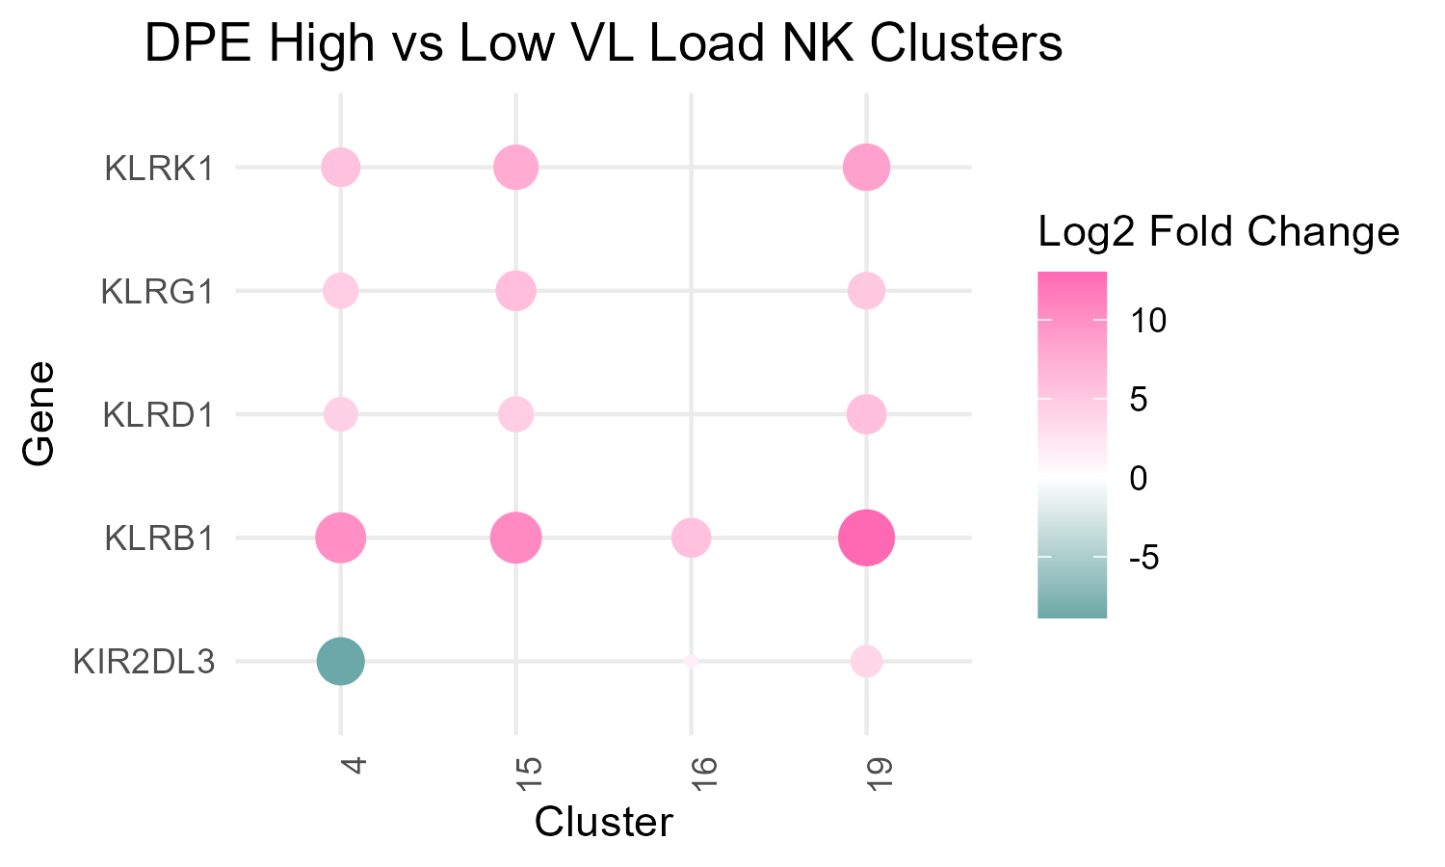
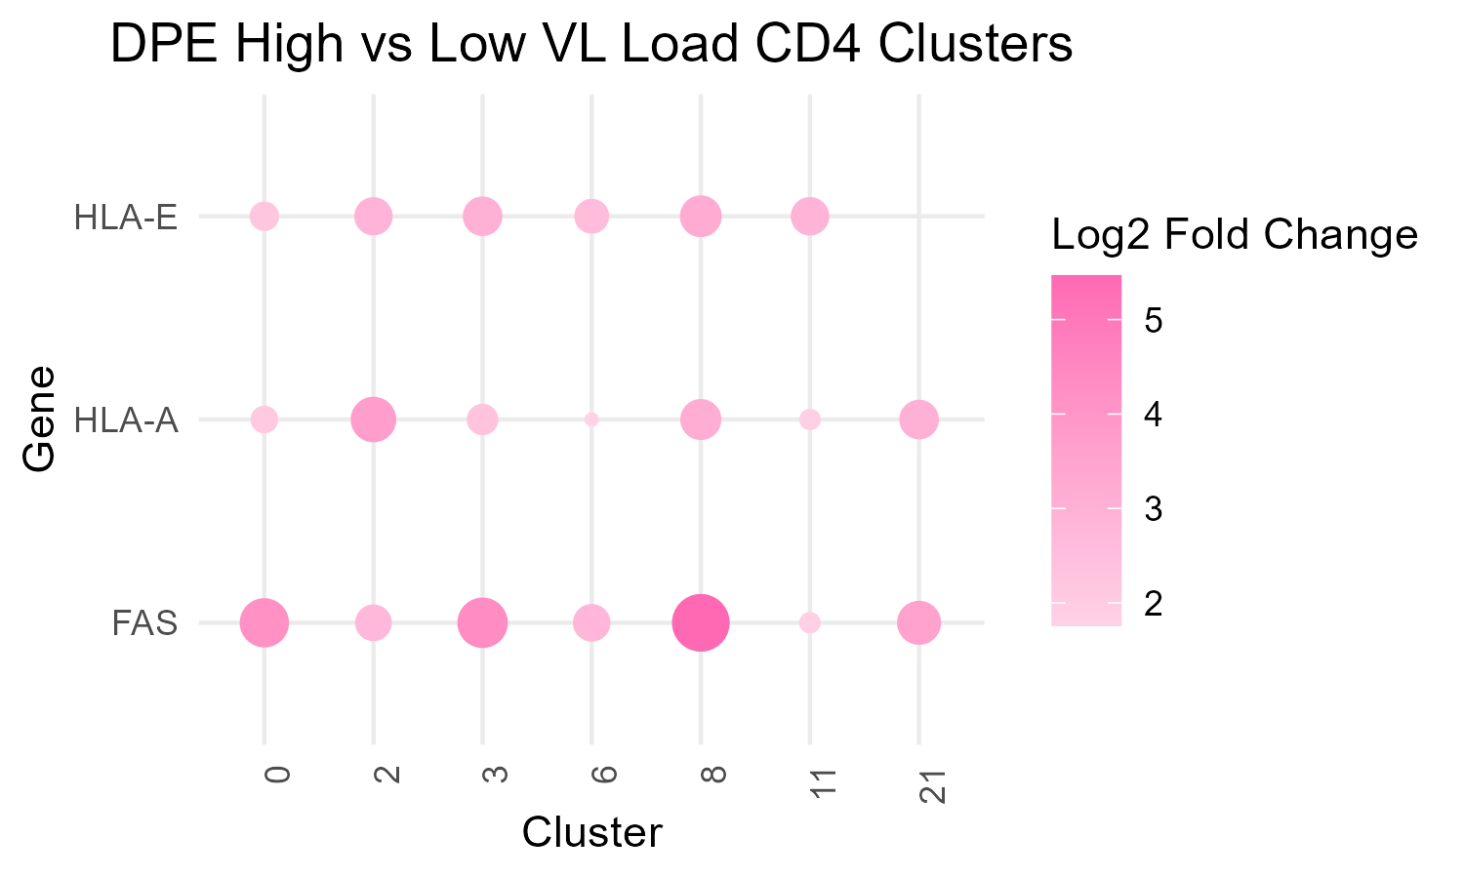
A
B
NCAM1 (gene)
CD56 (protein)
“High”
Cluster Identity
1 2 3
1 3 10 30
FCGR3A (gene)
CD16 (protein)
NK clusters
“Low”
C
D
1 2 3
Expression Level
1 3 10 30
E
F
CD4 clusters
Notes:
Figure 7

Slide 10
Supplementary Data

Slide 11
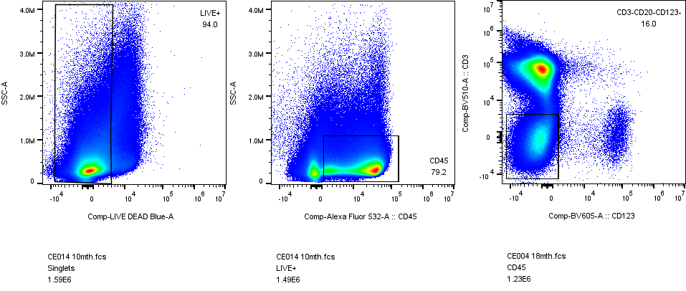
Gated on singlets
Gated on i.
Gated on ii.
i
CD3/CD19 BV510
Side Scatter
Side Scatter
ii
iii
Live Dead Blue
CD45 AF532
CD123 BV605
Gated on iii.
Gated on iv.
Gated on v.
CD14 BB700
CD56 BUV563
CD56 BUV563
v
iv
HLADR BUV661
CD16 BUV496
CD16 BUV496
Notes:
Supplemental Figure 1. Flow plots indicate the gating scheme for NK cells: Live CD45+CD3-CD19-CD123-CD14-.

Slide 12
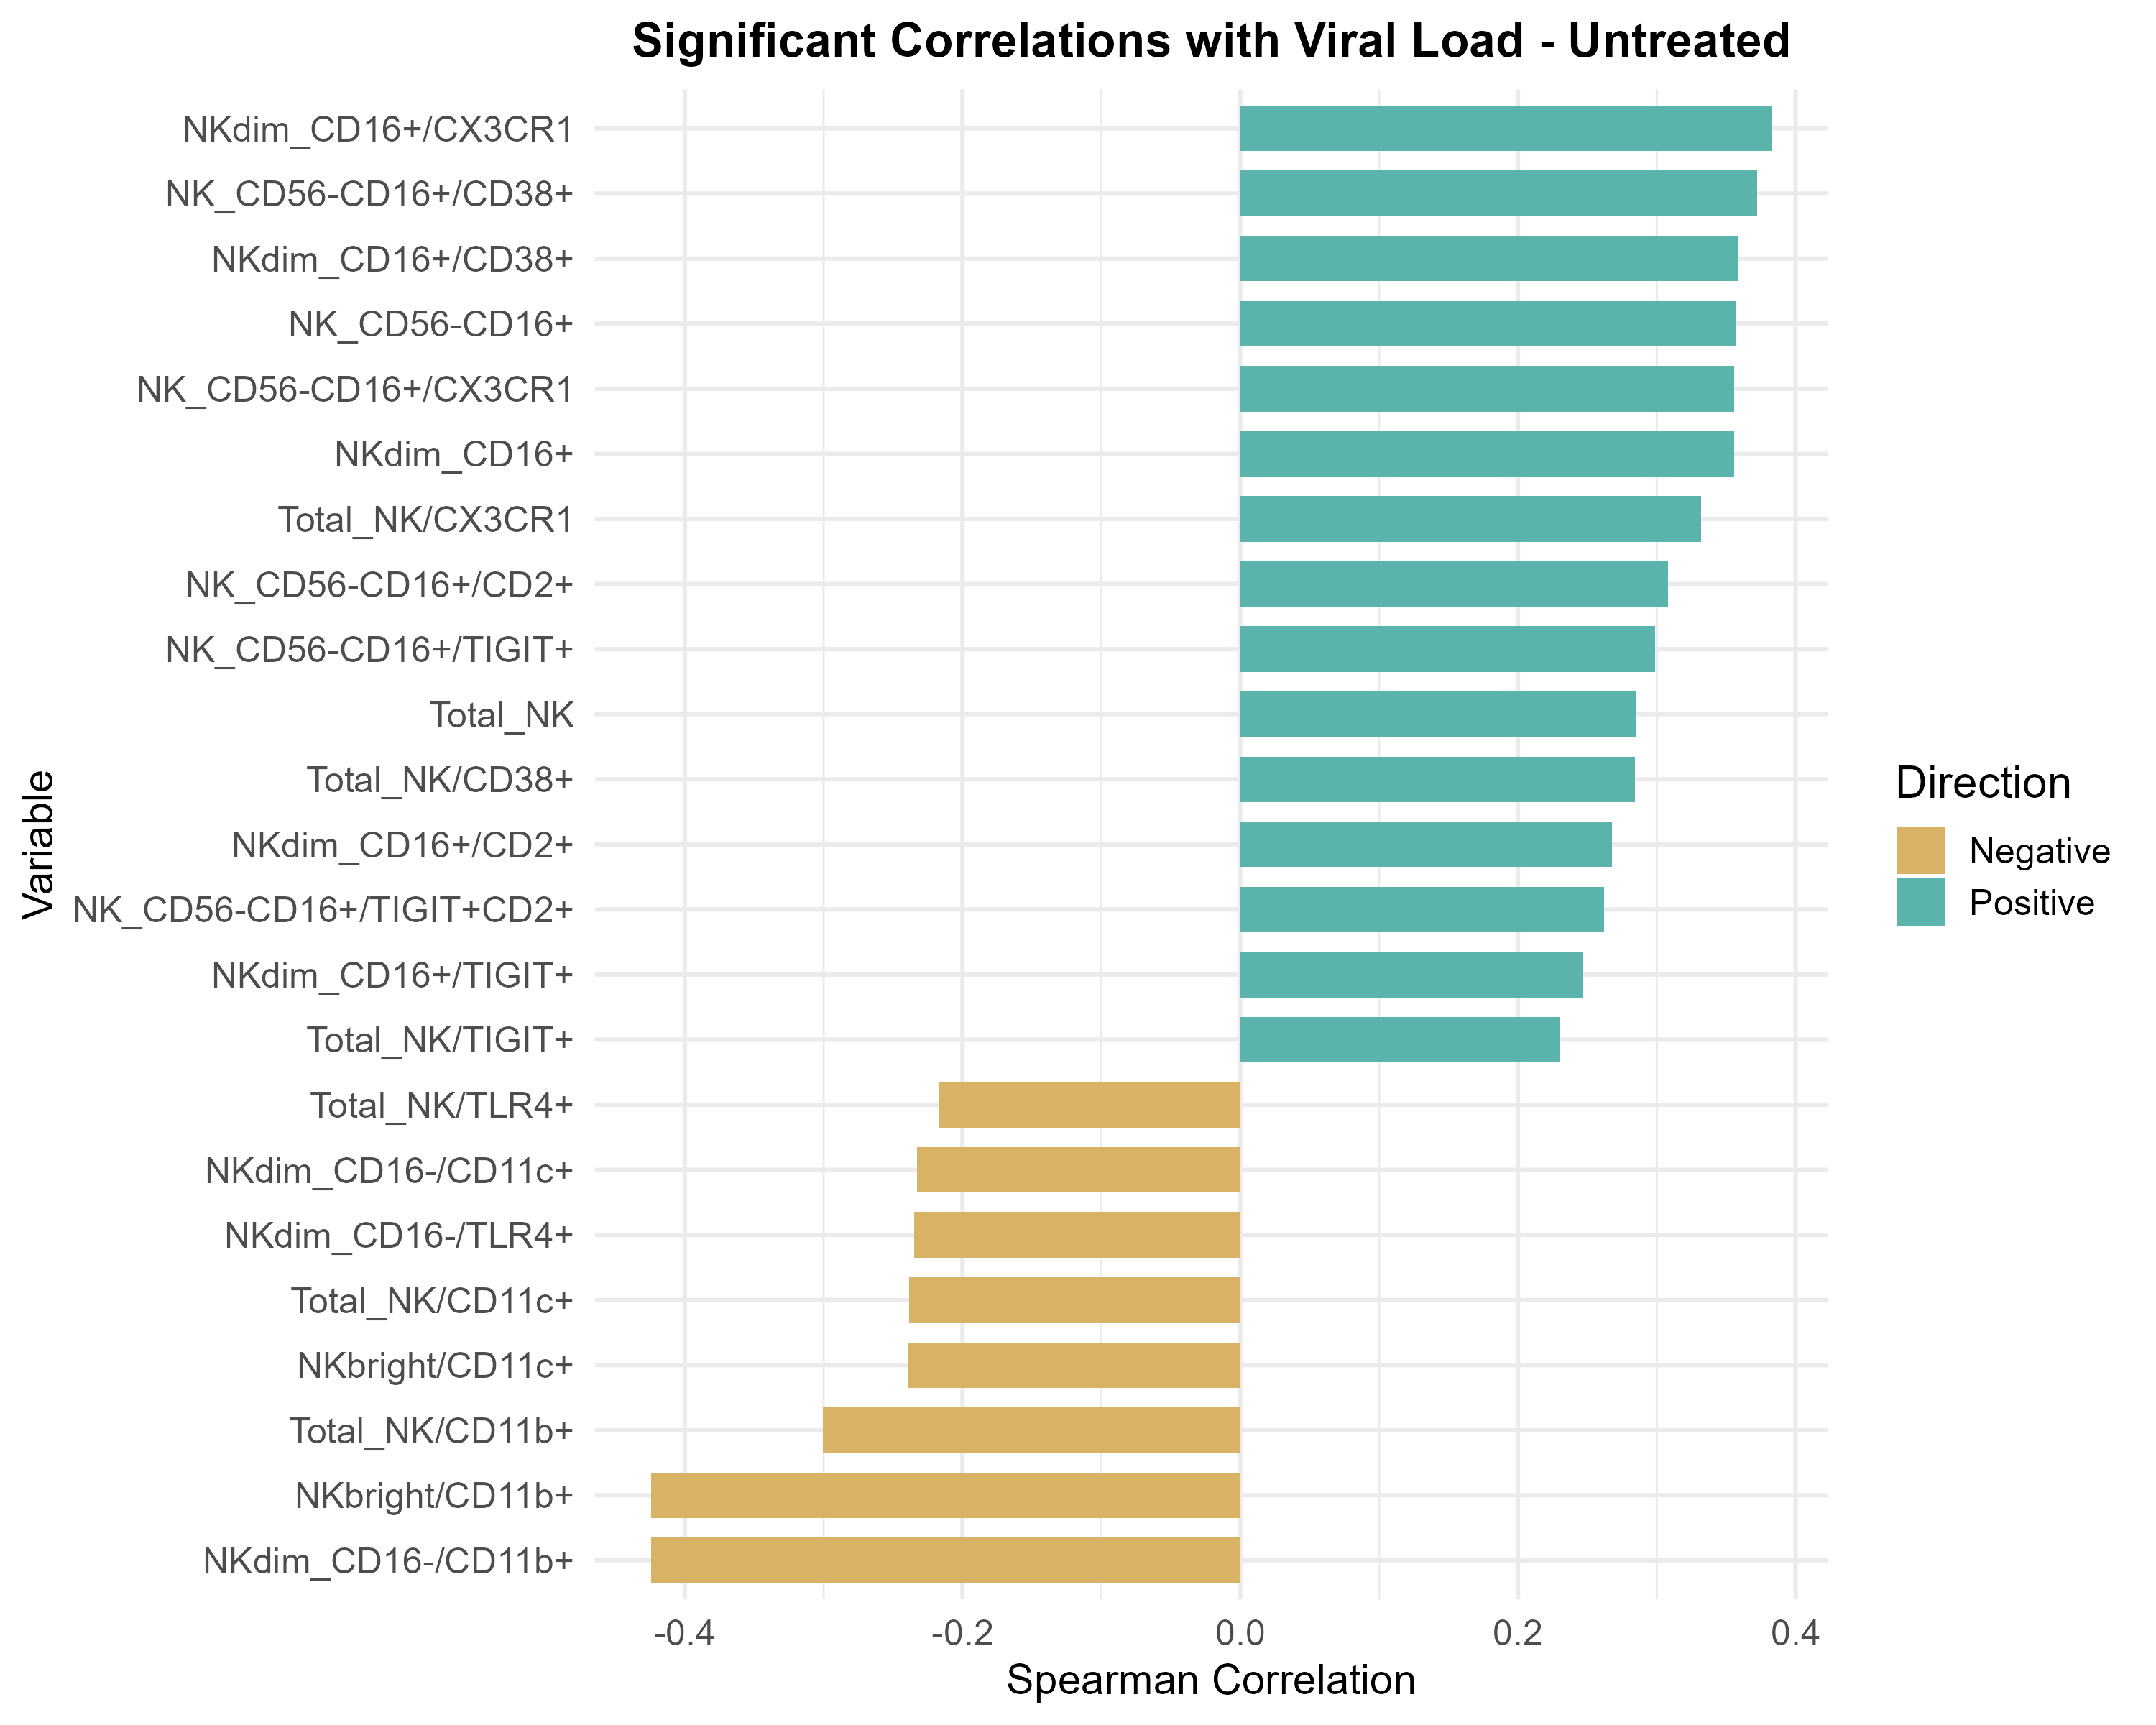
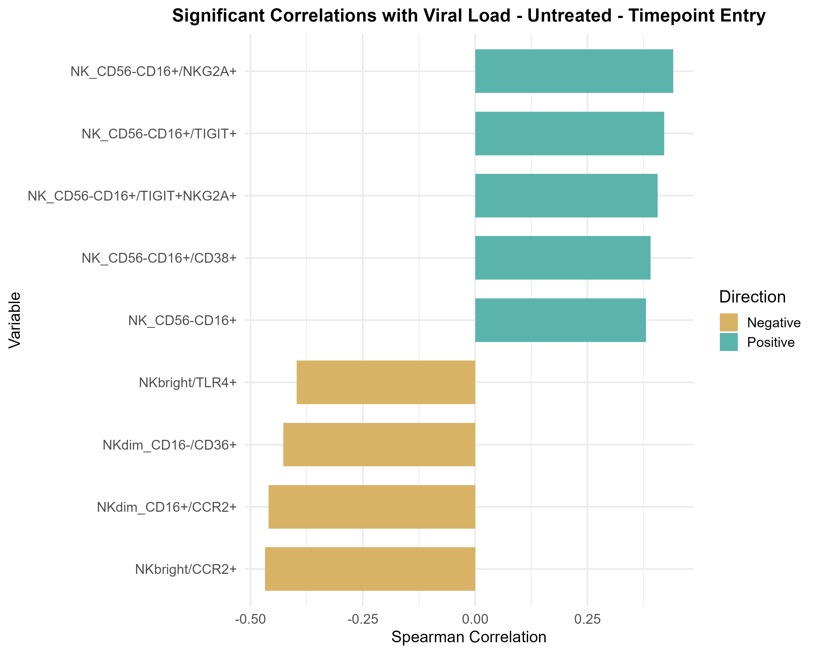
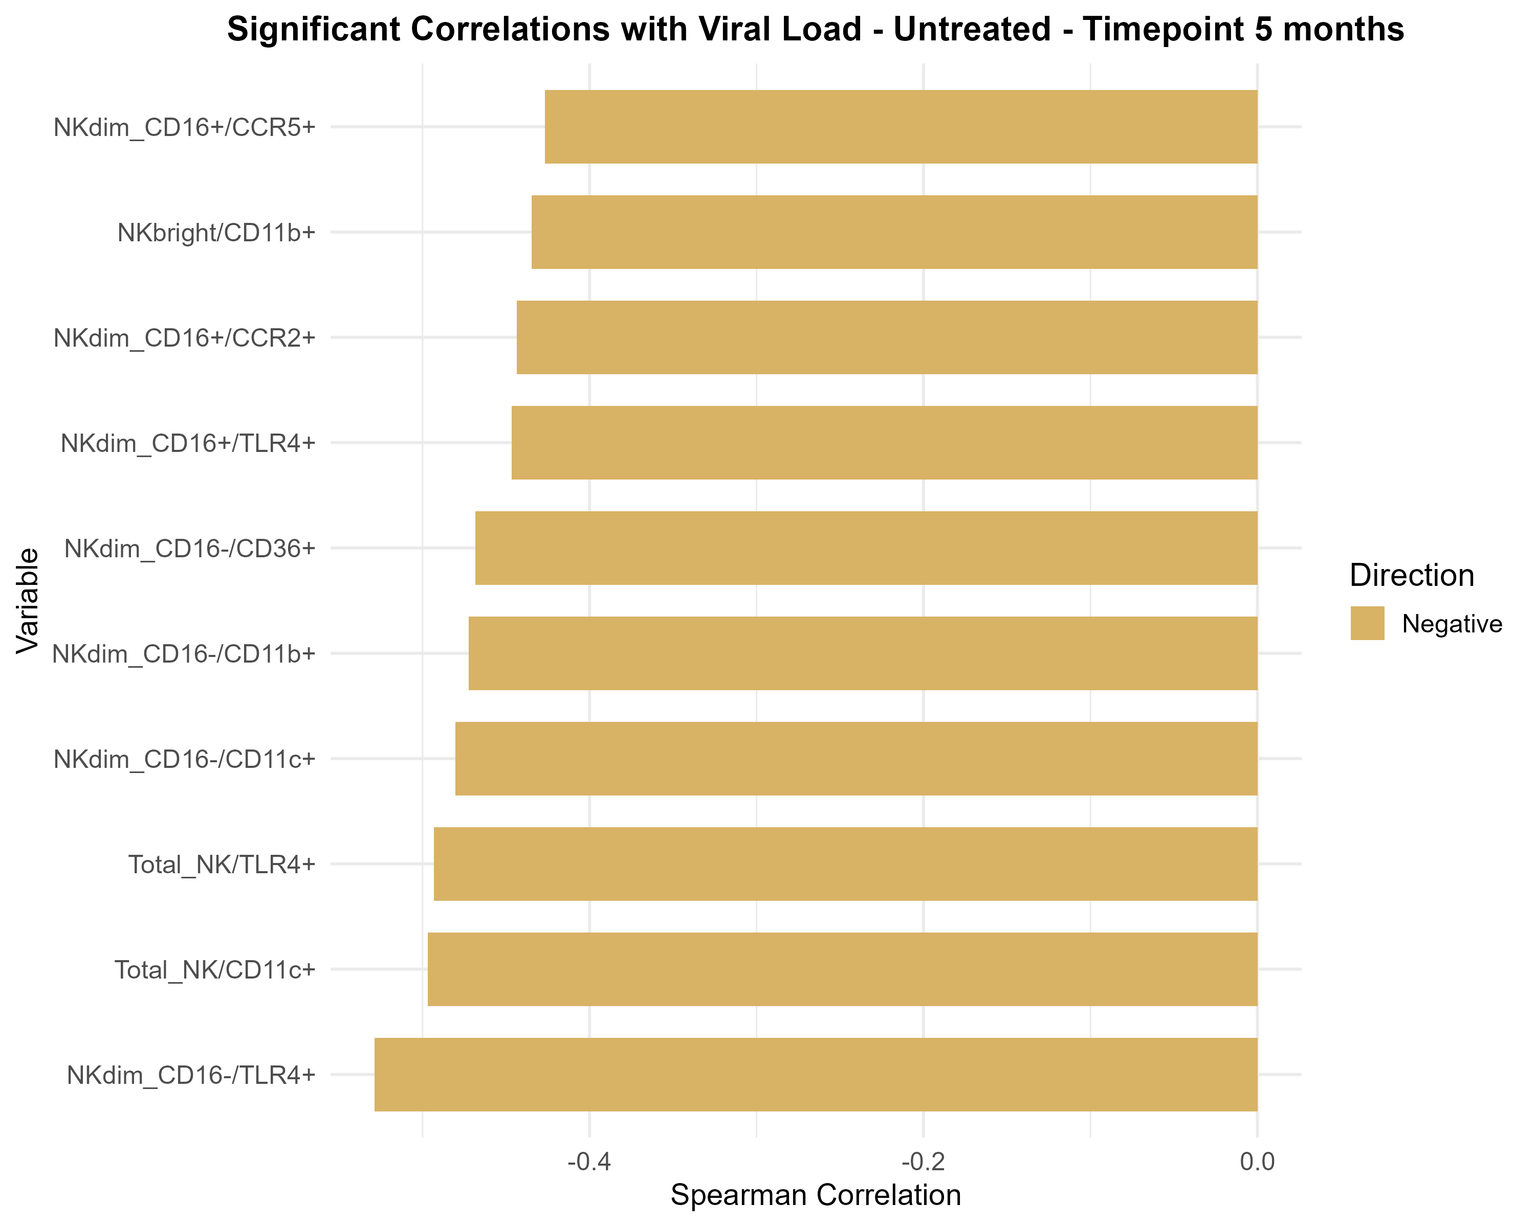
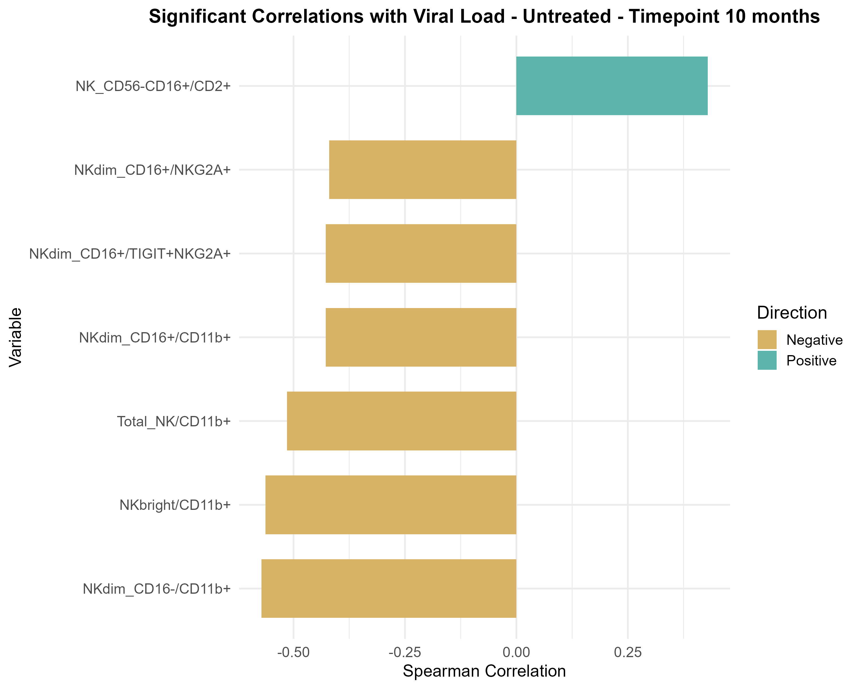
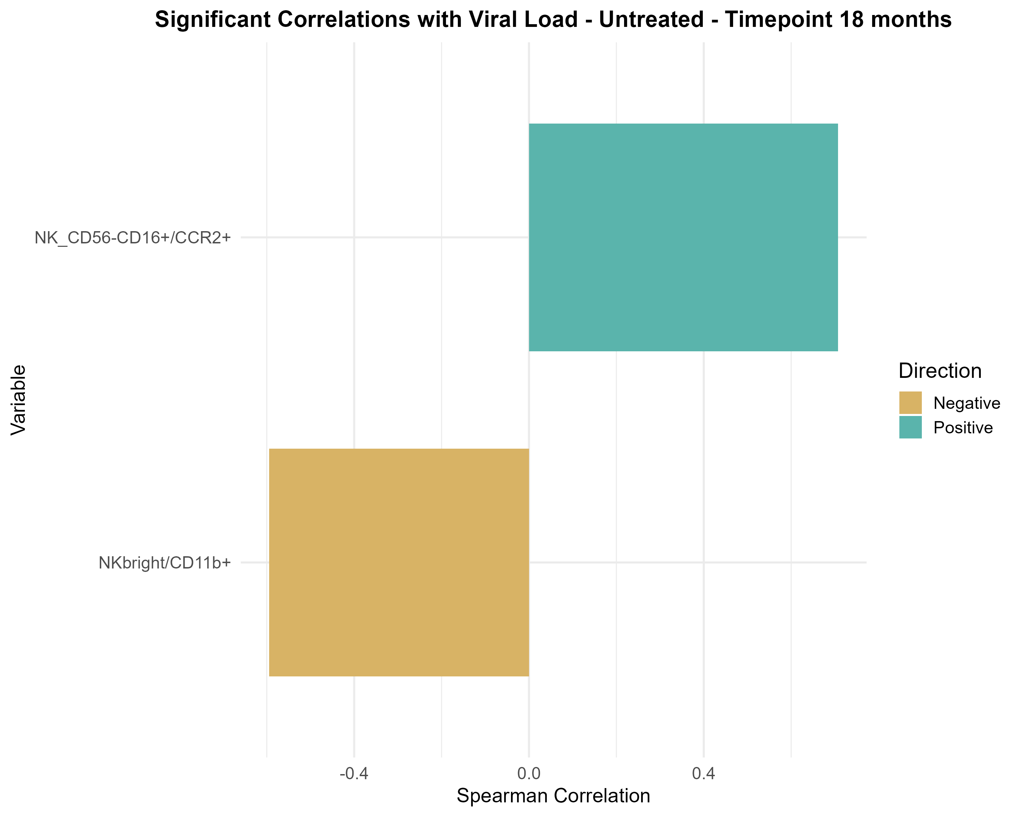
*
*
*
Notes:
Supplementary Figure 2. NK cell phenotypic subset frequencies correlate with plasma virus load measurements. Spearman correlation was performed at each timepoint and all timpoints combined between the flow cytometric phenotypic data

Slide 13
ENTRY
12m
Notes:
Supplementary Figure 3. Impact of IL-15 on NK effector functions in co-culture assay. Frequencies of Target cell death (specific killing), CD107a-, IFNg-, MIP1b-, and TNFa-expressing CD56dimCD16+ cells are shown at entry (left column) and 12m (right column). HEU and HEI donors are combined since there were no significant differences in the groups for any of these readouts.

Slide 14
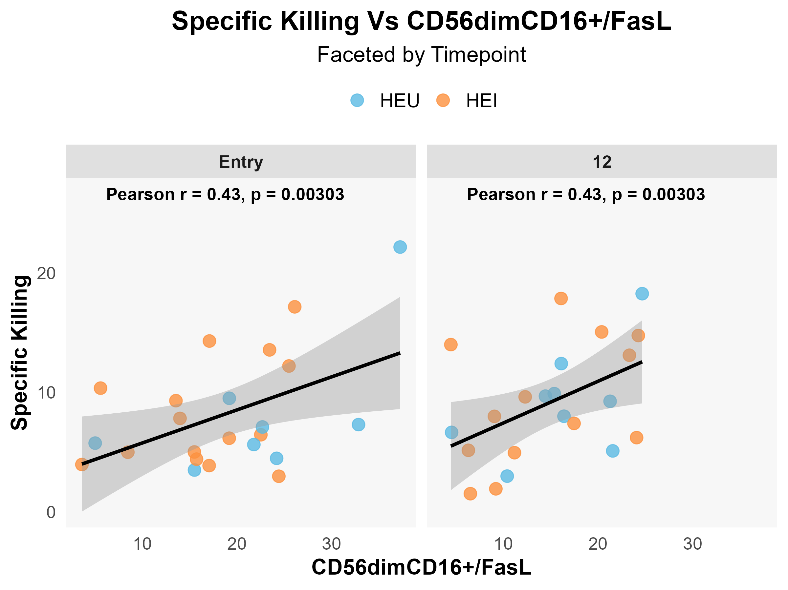
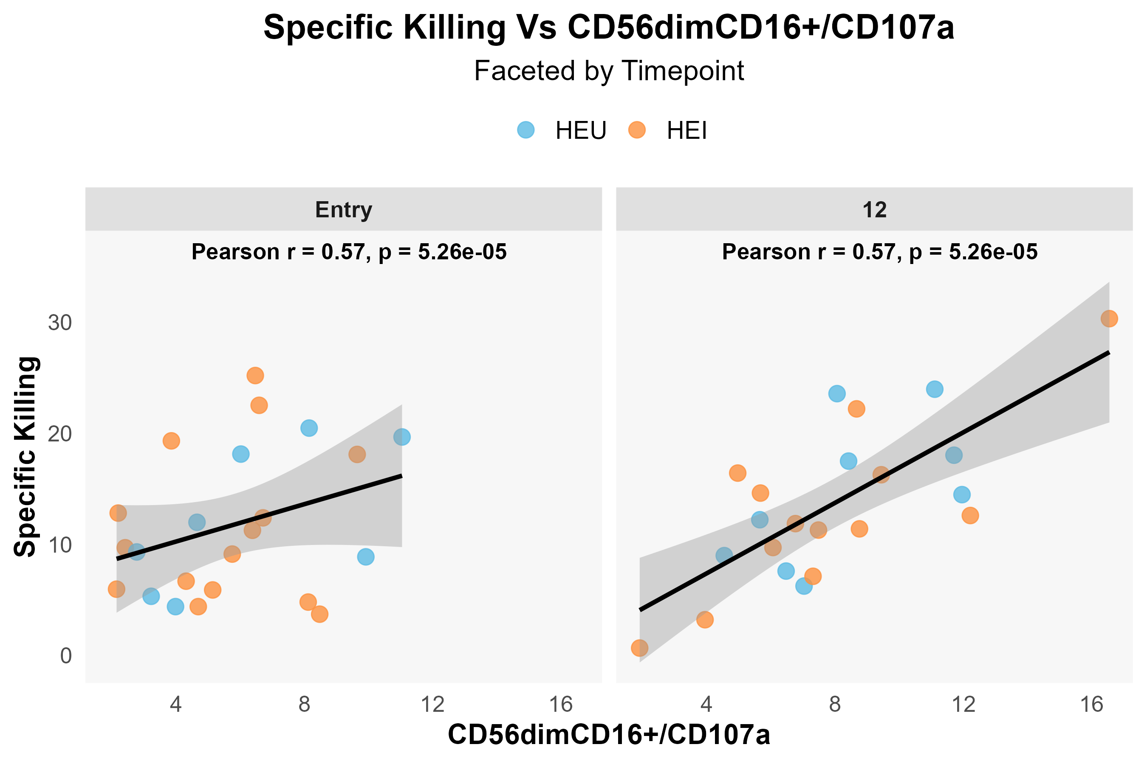
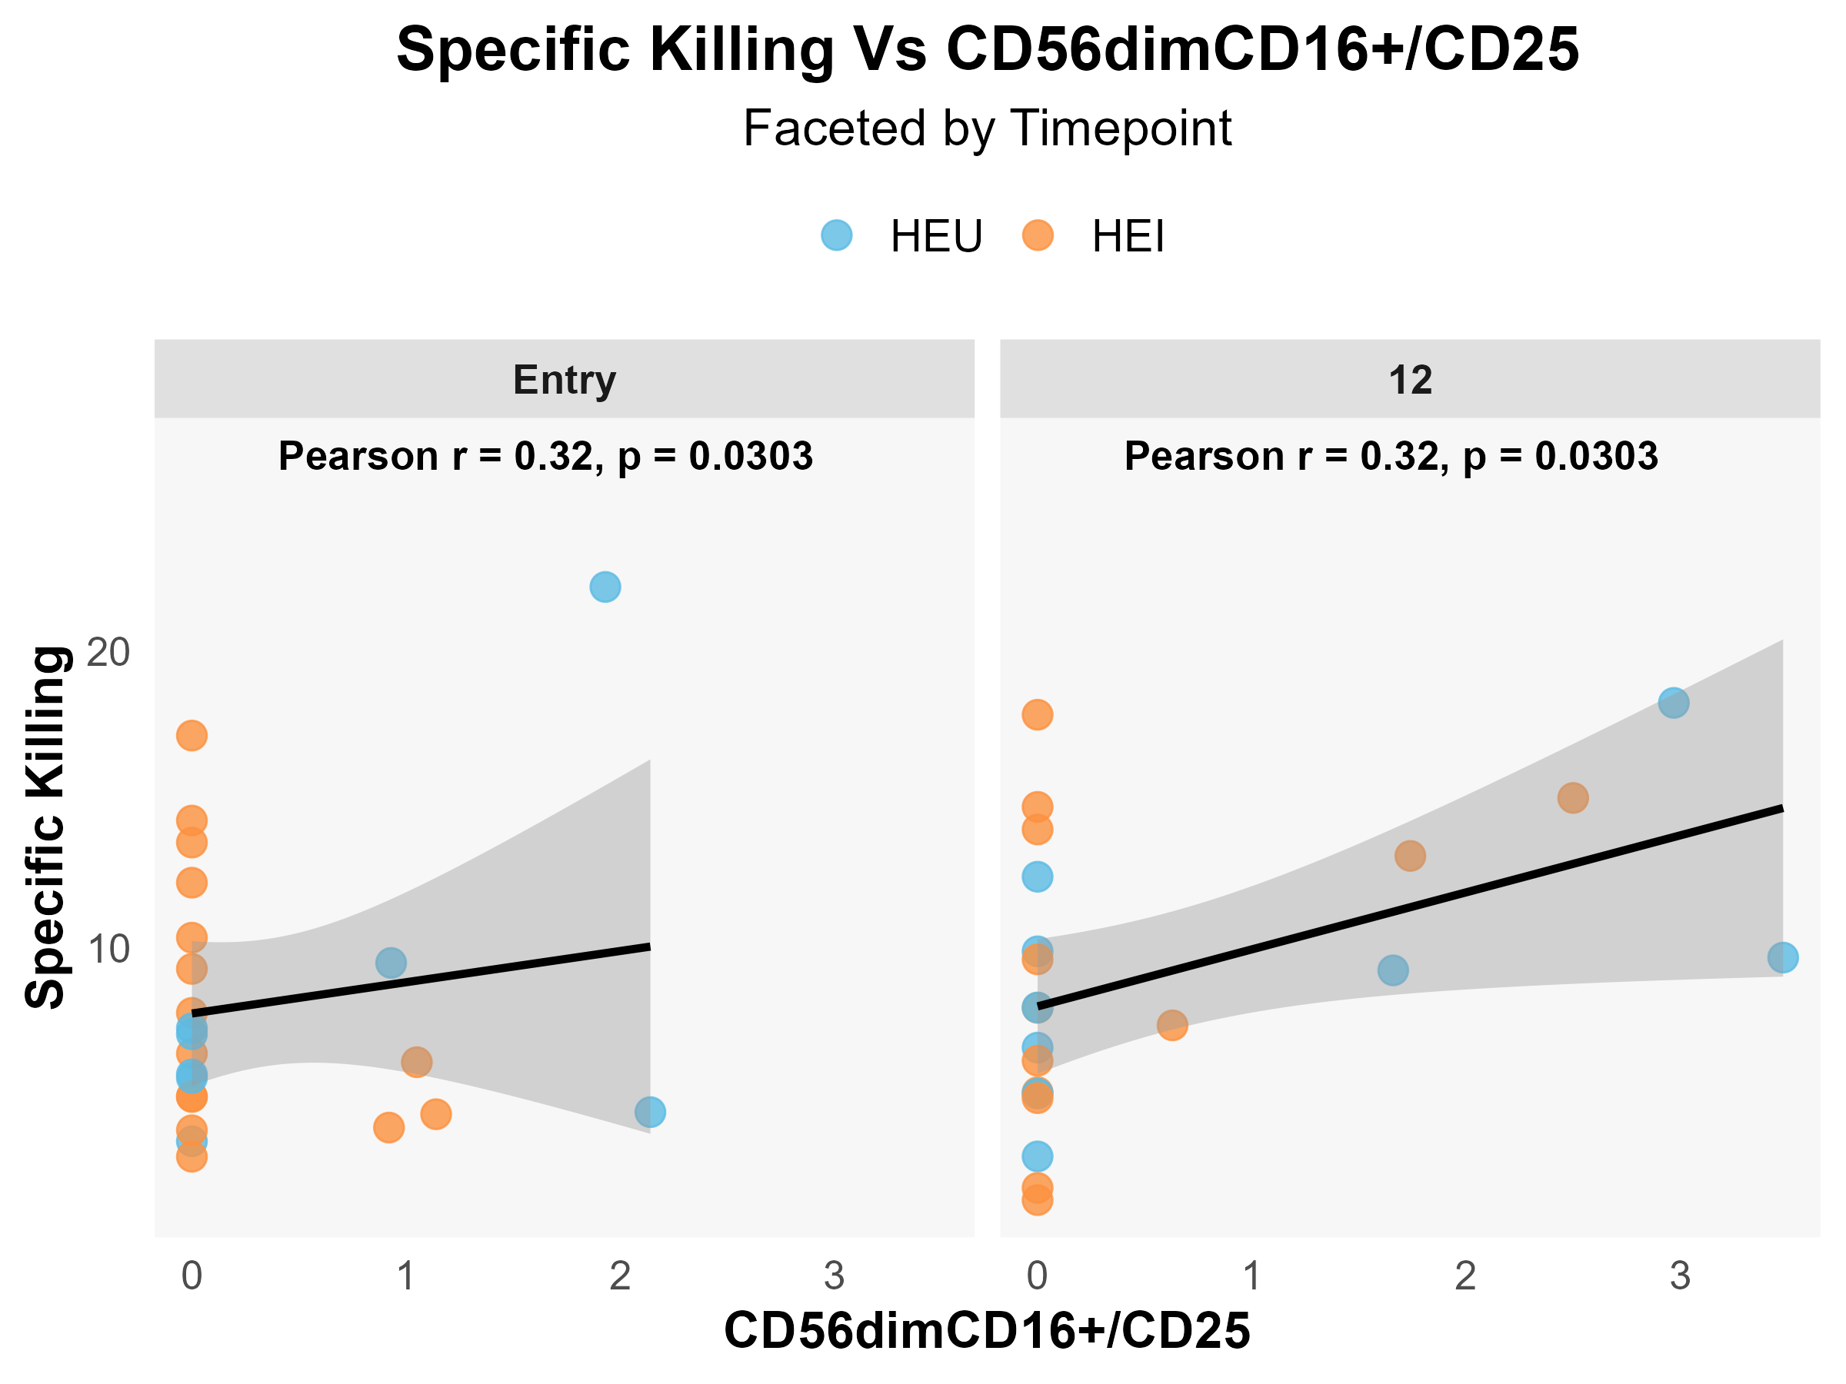
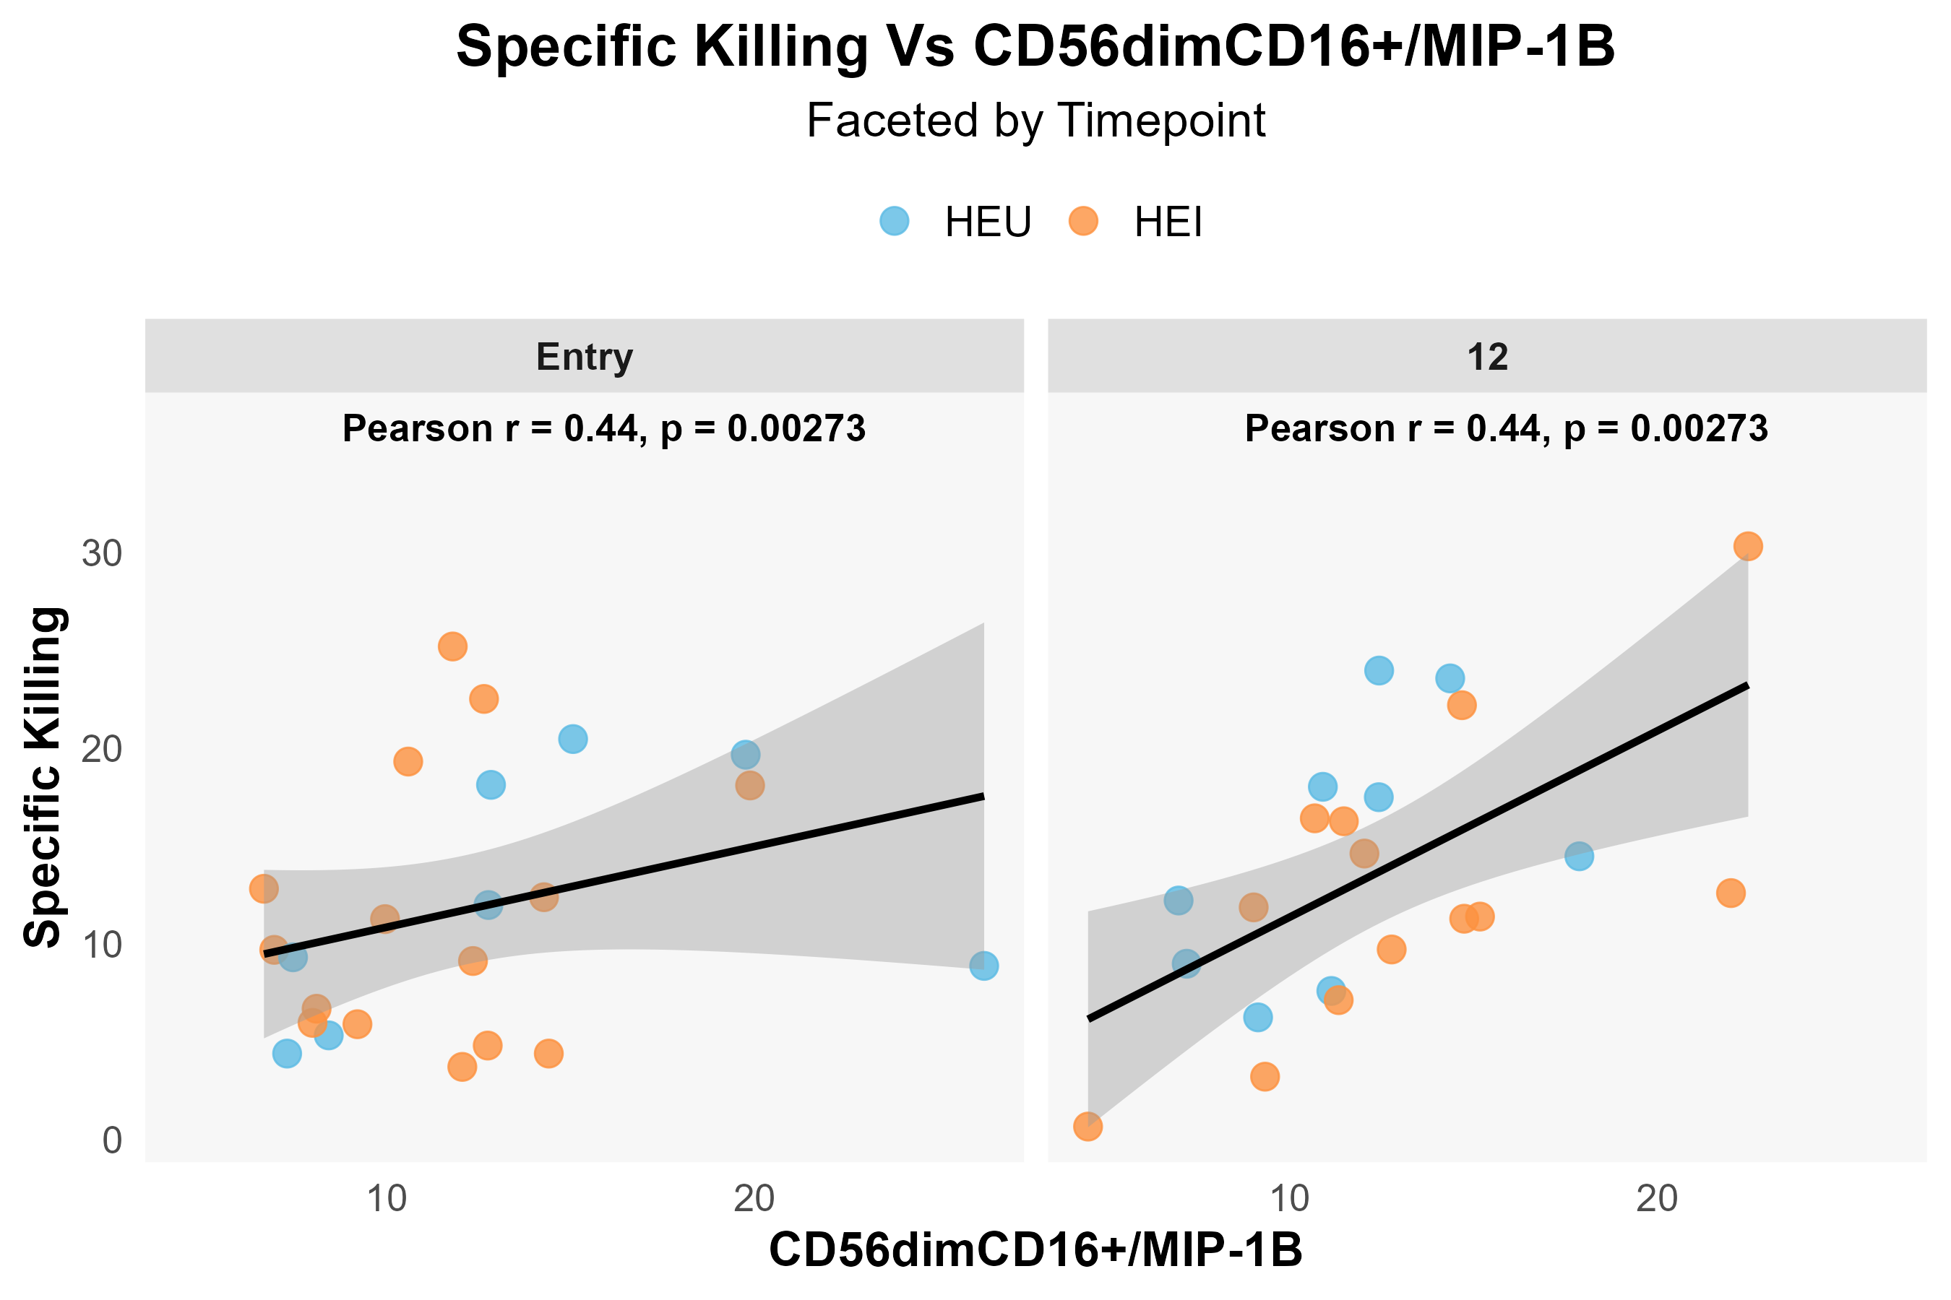
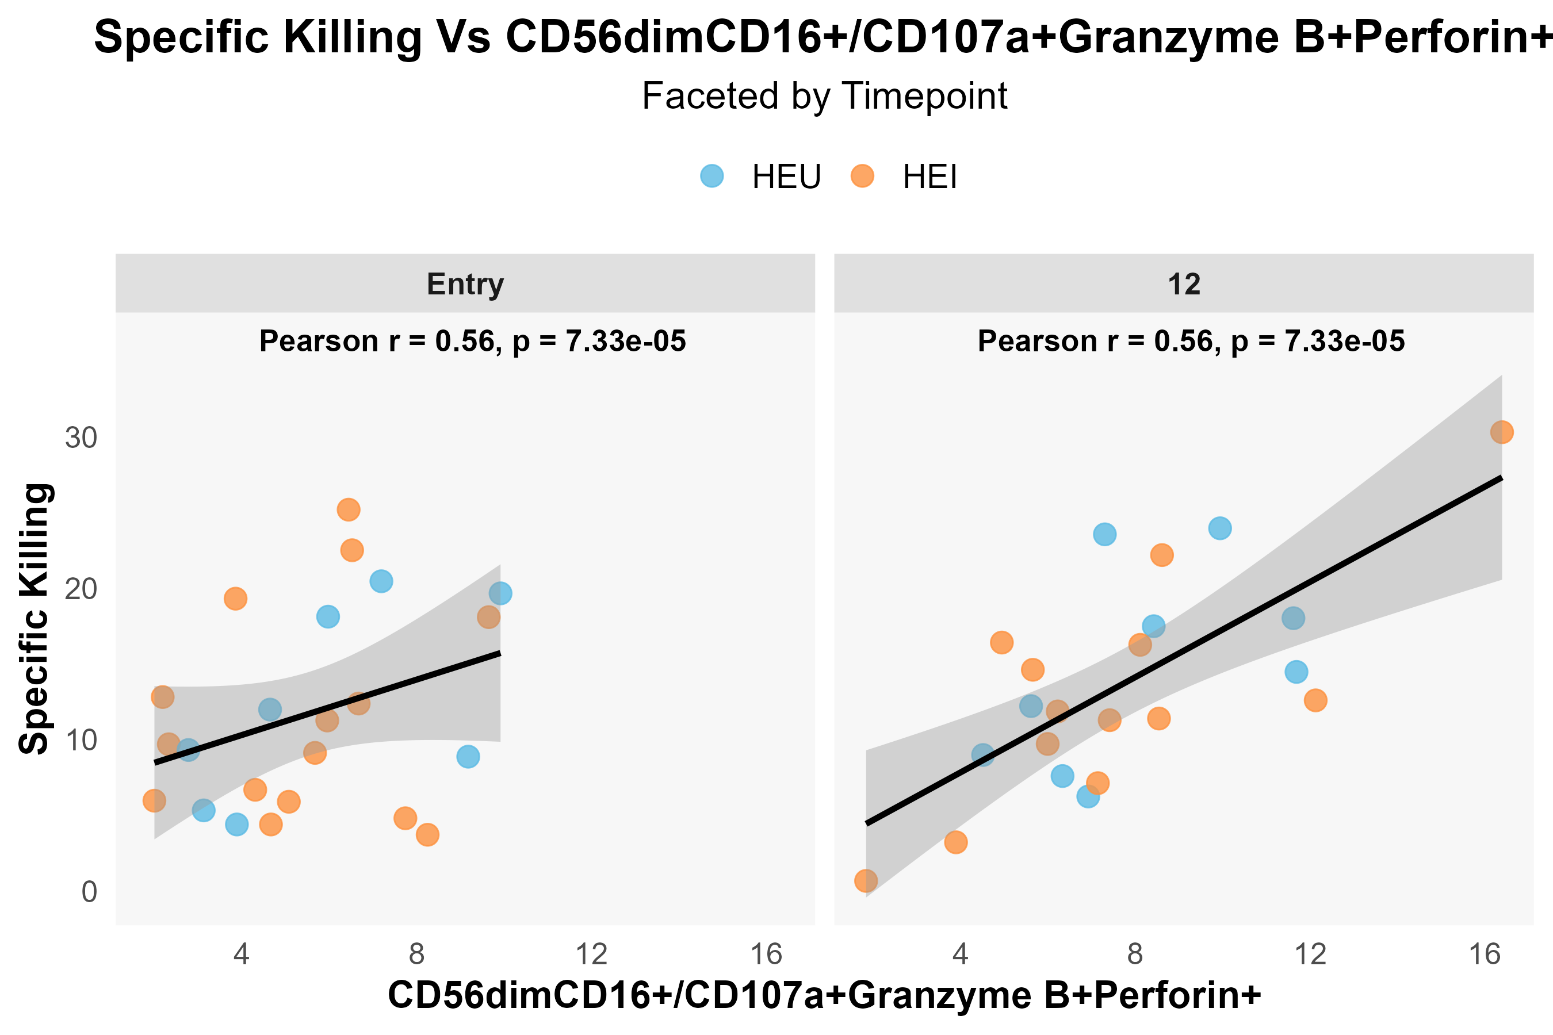
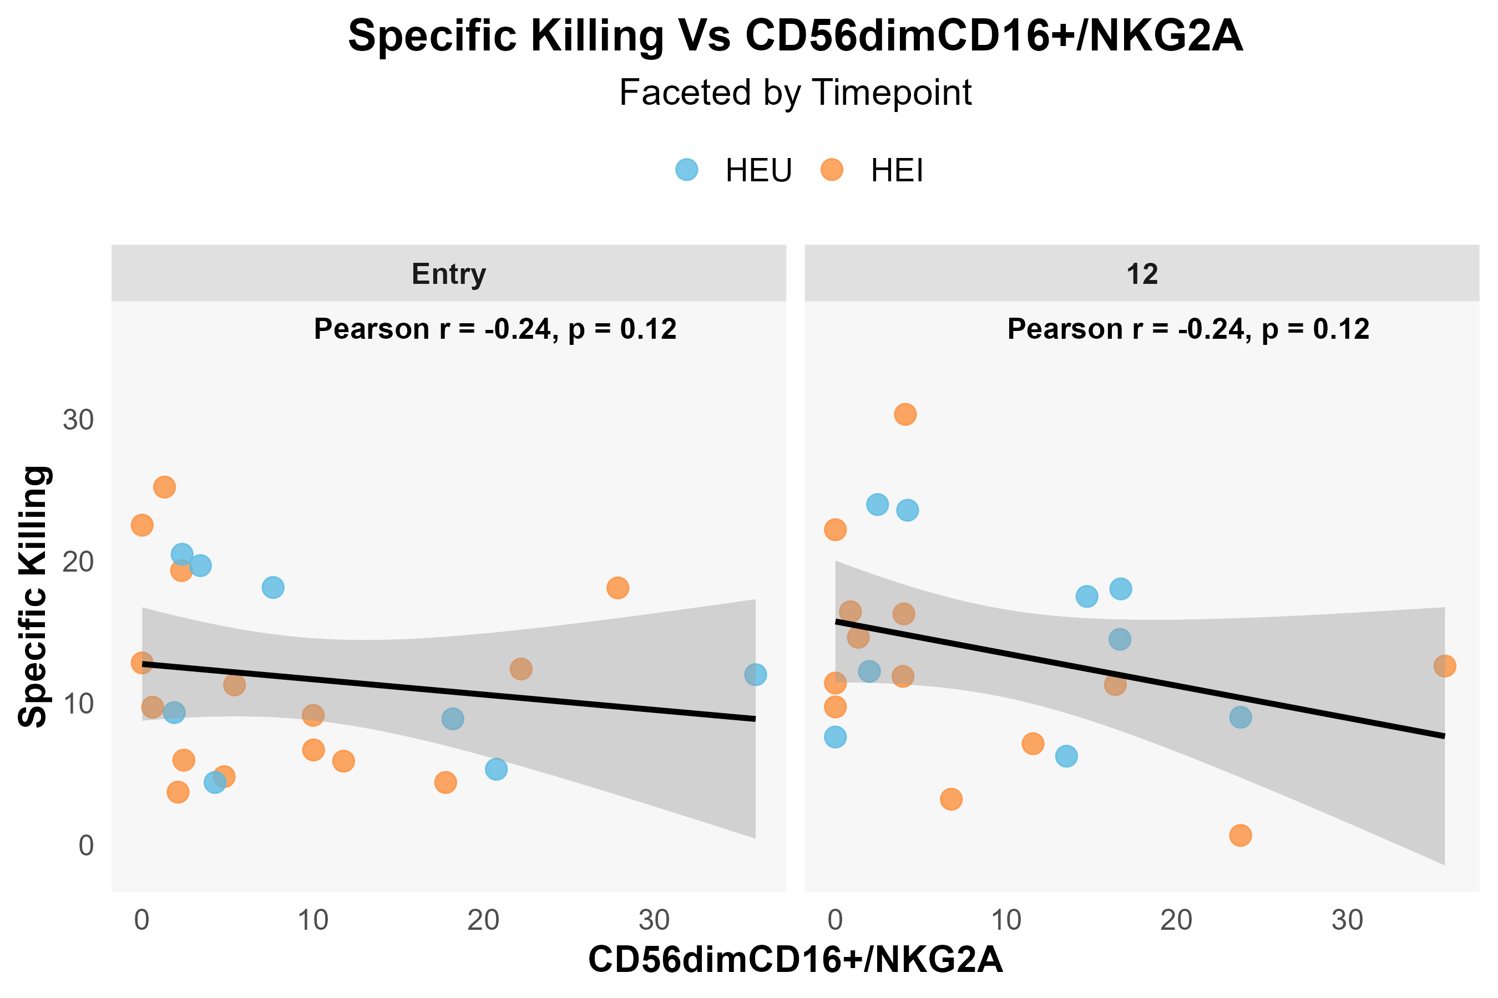
HUT78
K562
Notes:
Supplementary Figure 4. Related to Figure 5C and D

Slide 15
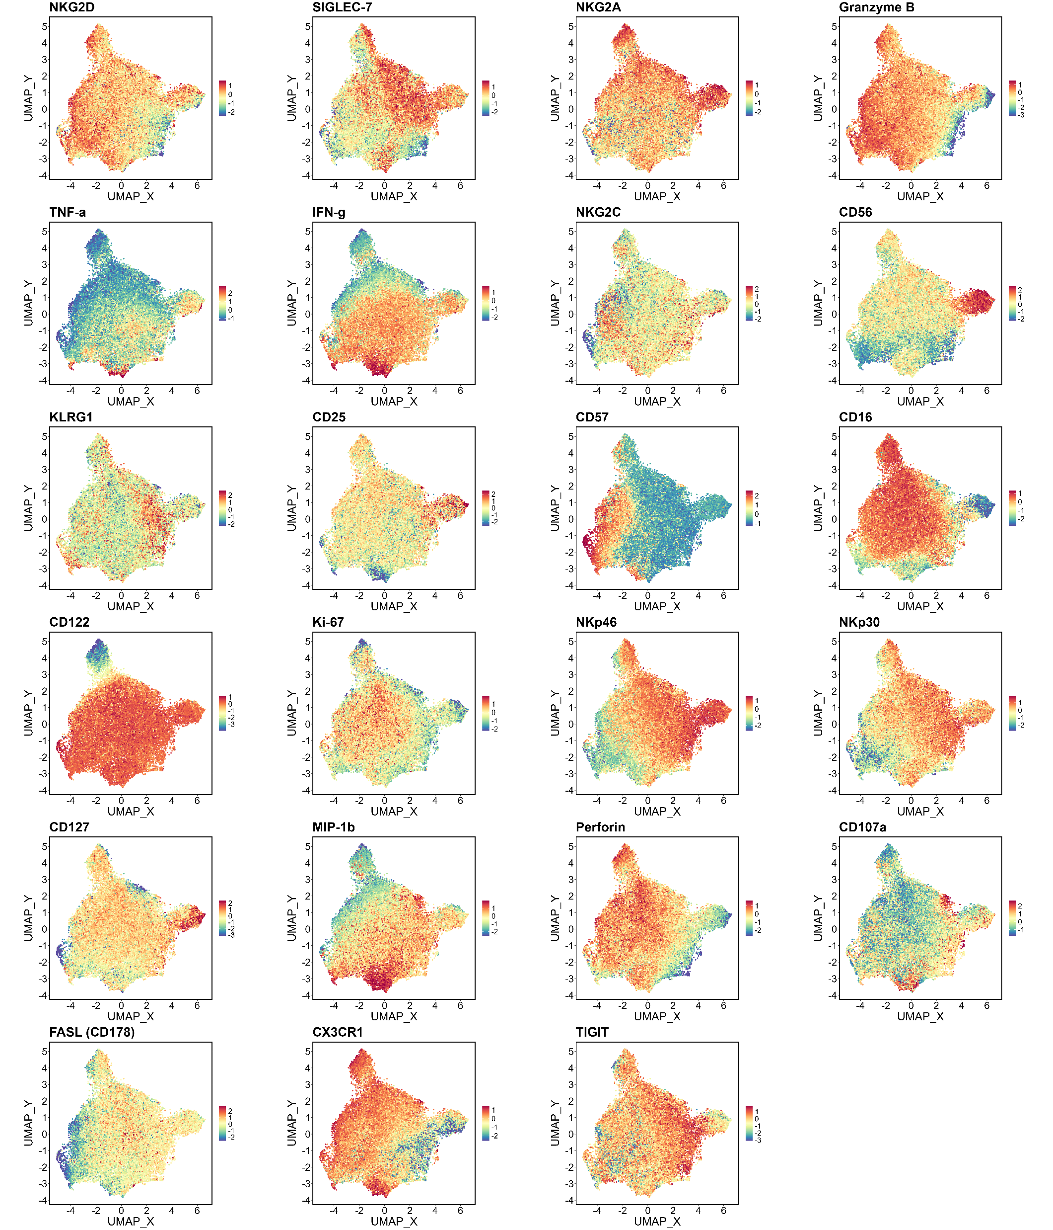
Notes:
Supplementary Figure 5.

Slide 16
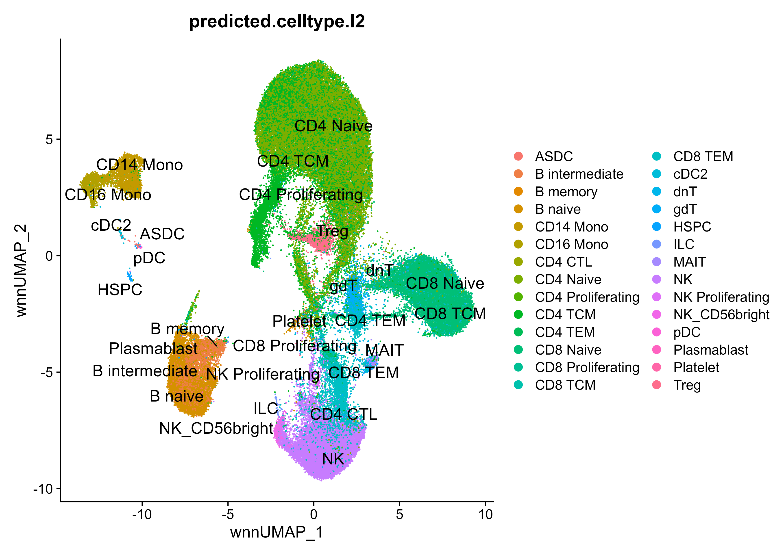
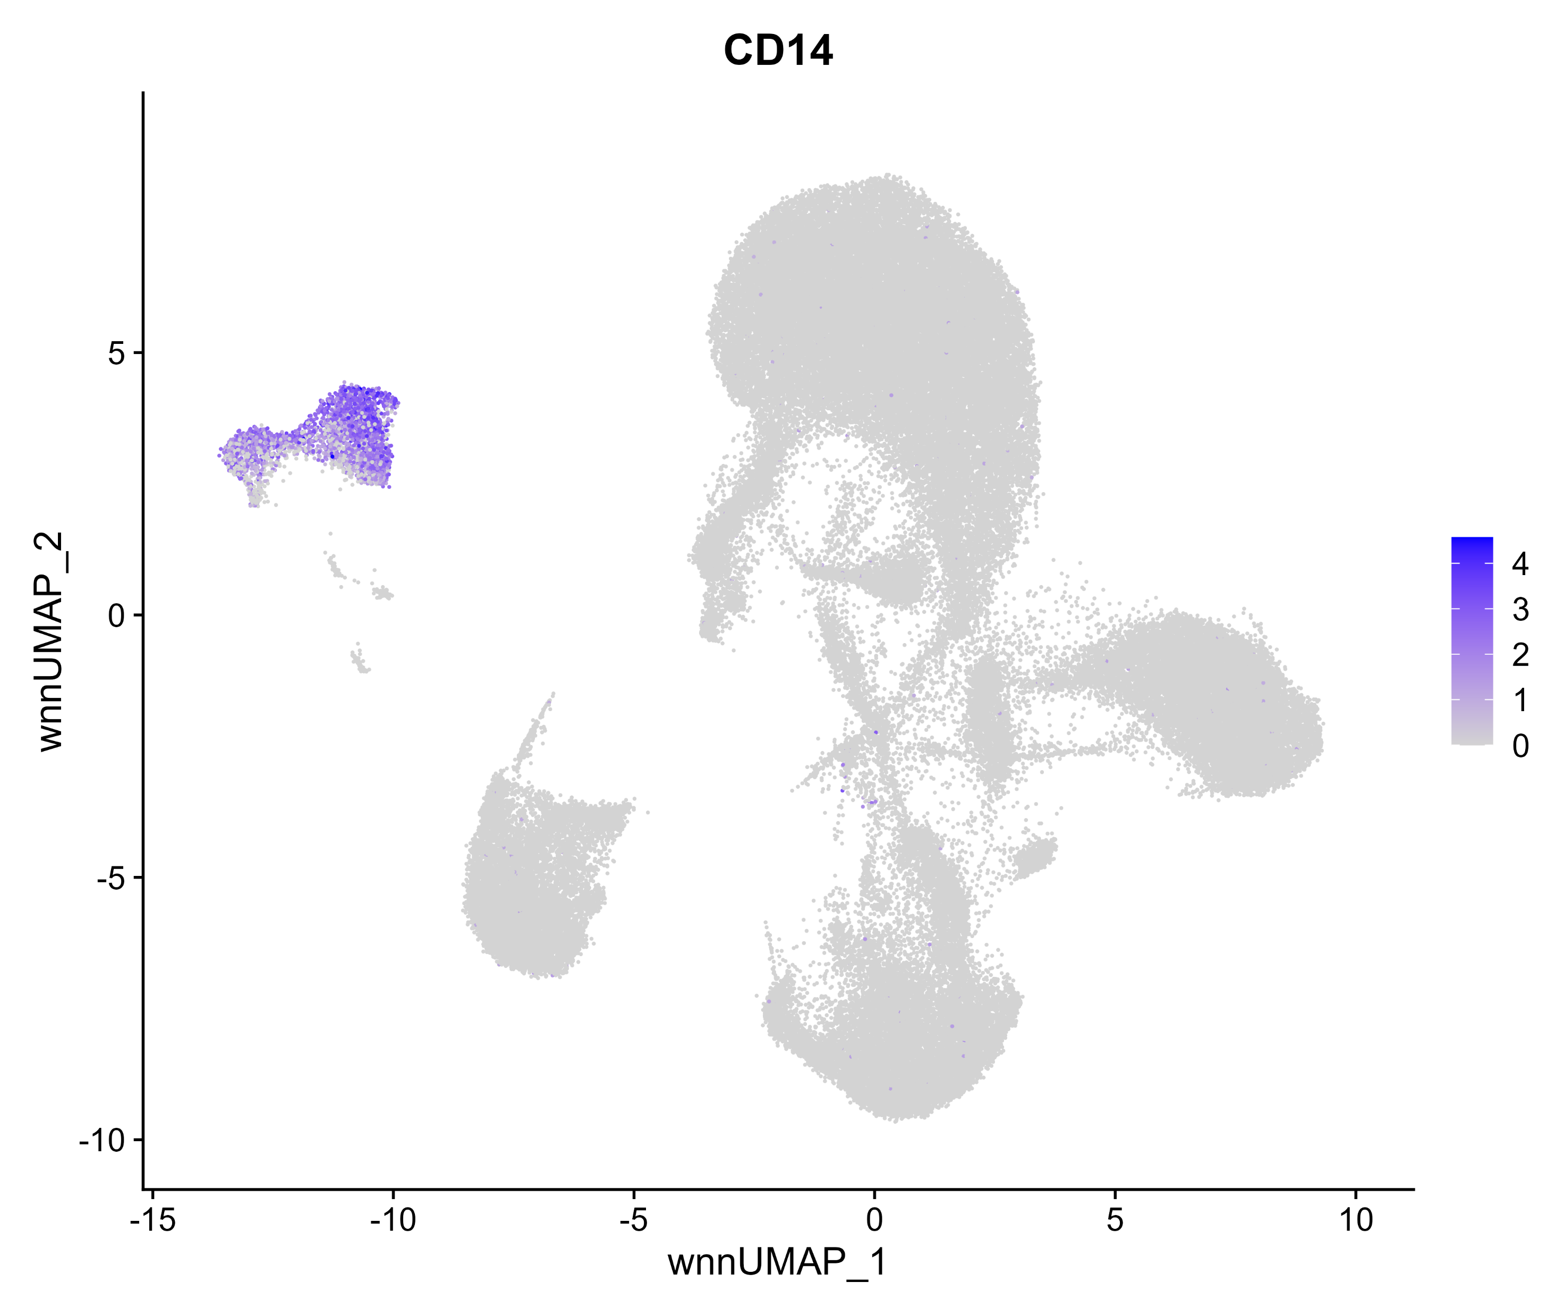
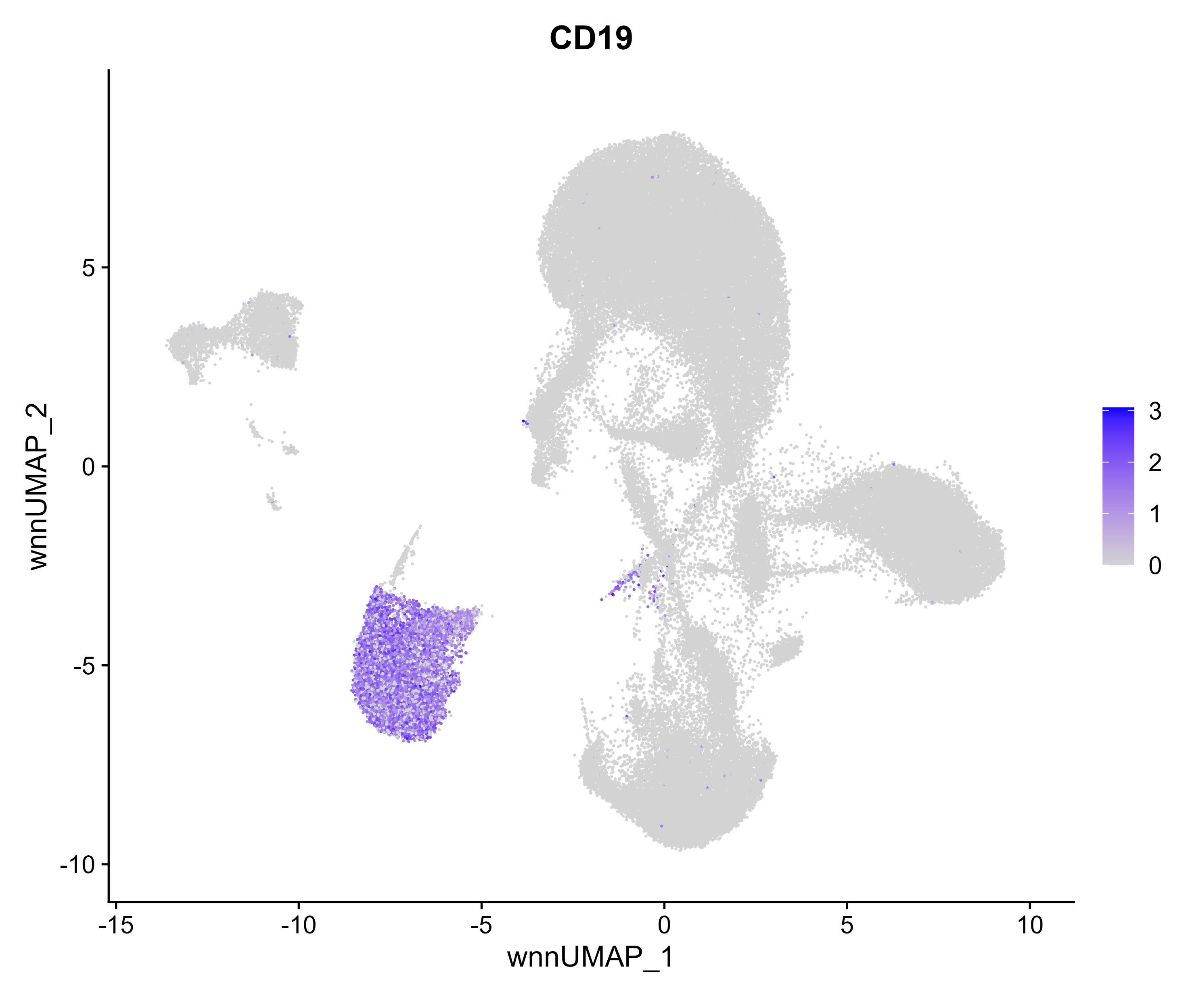
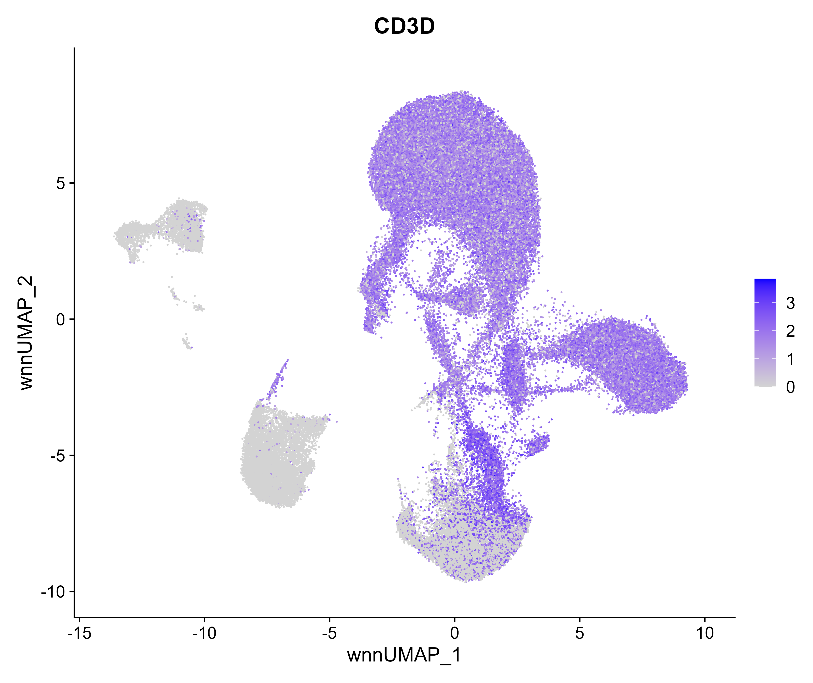
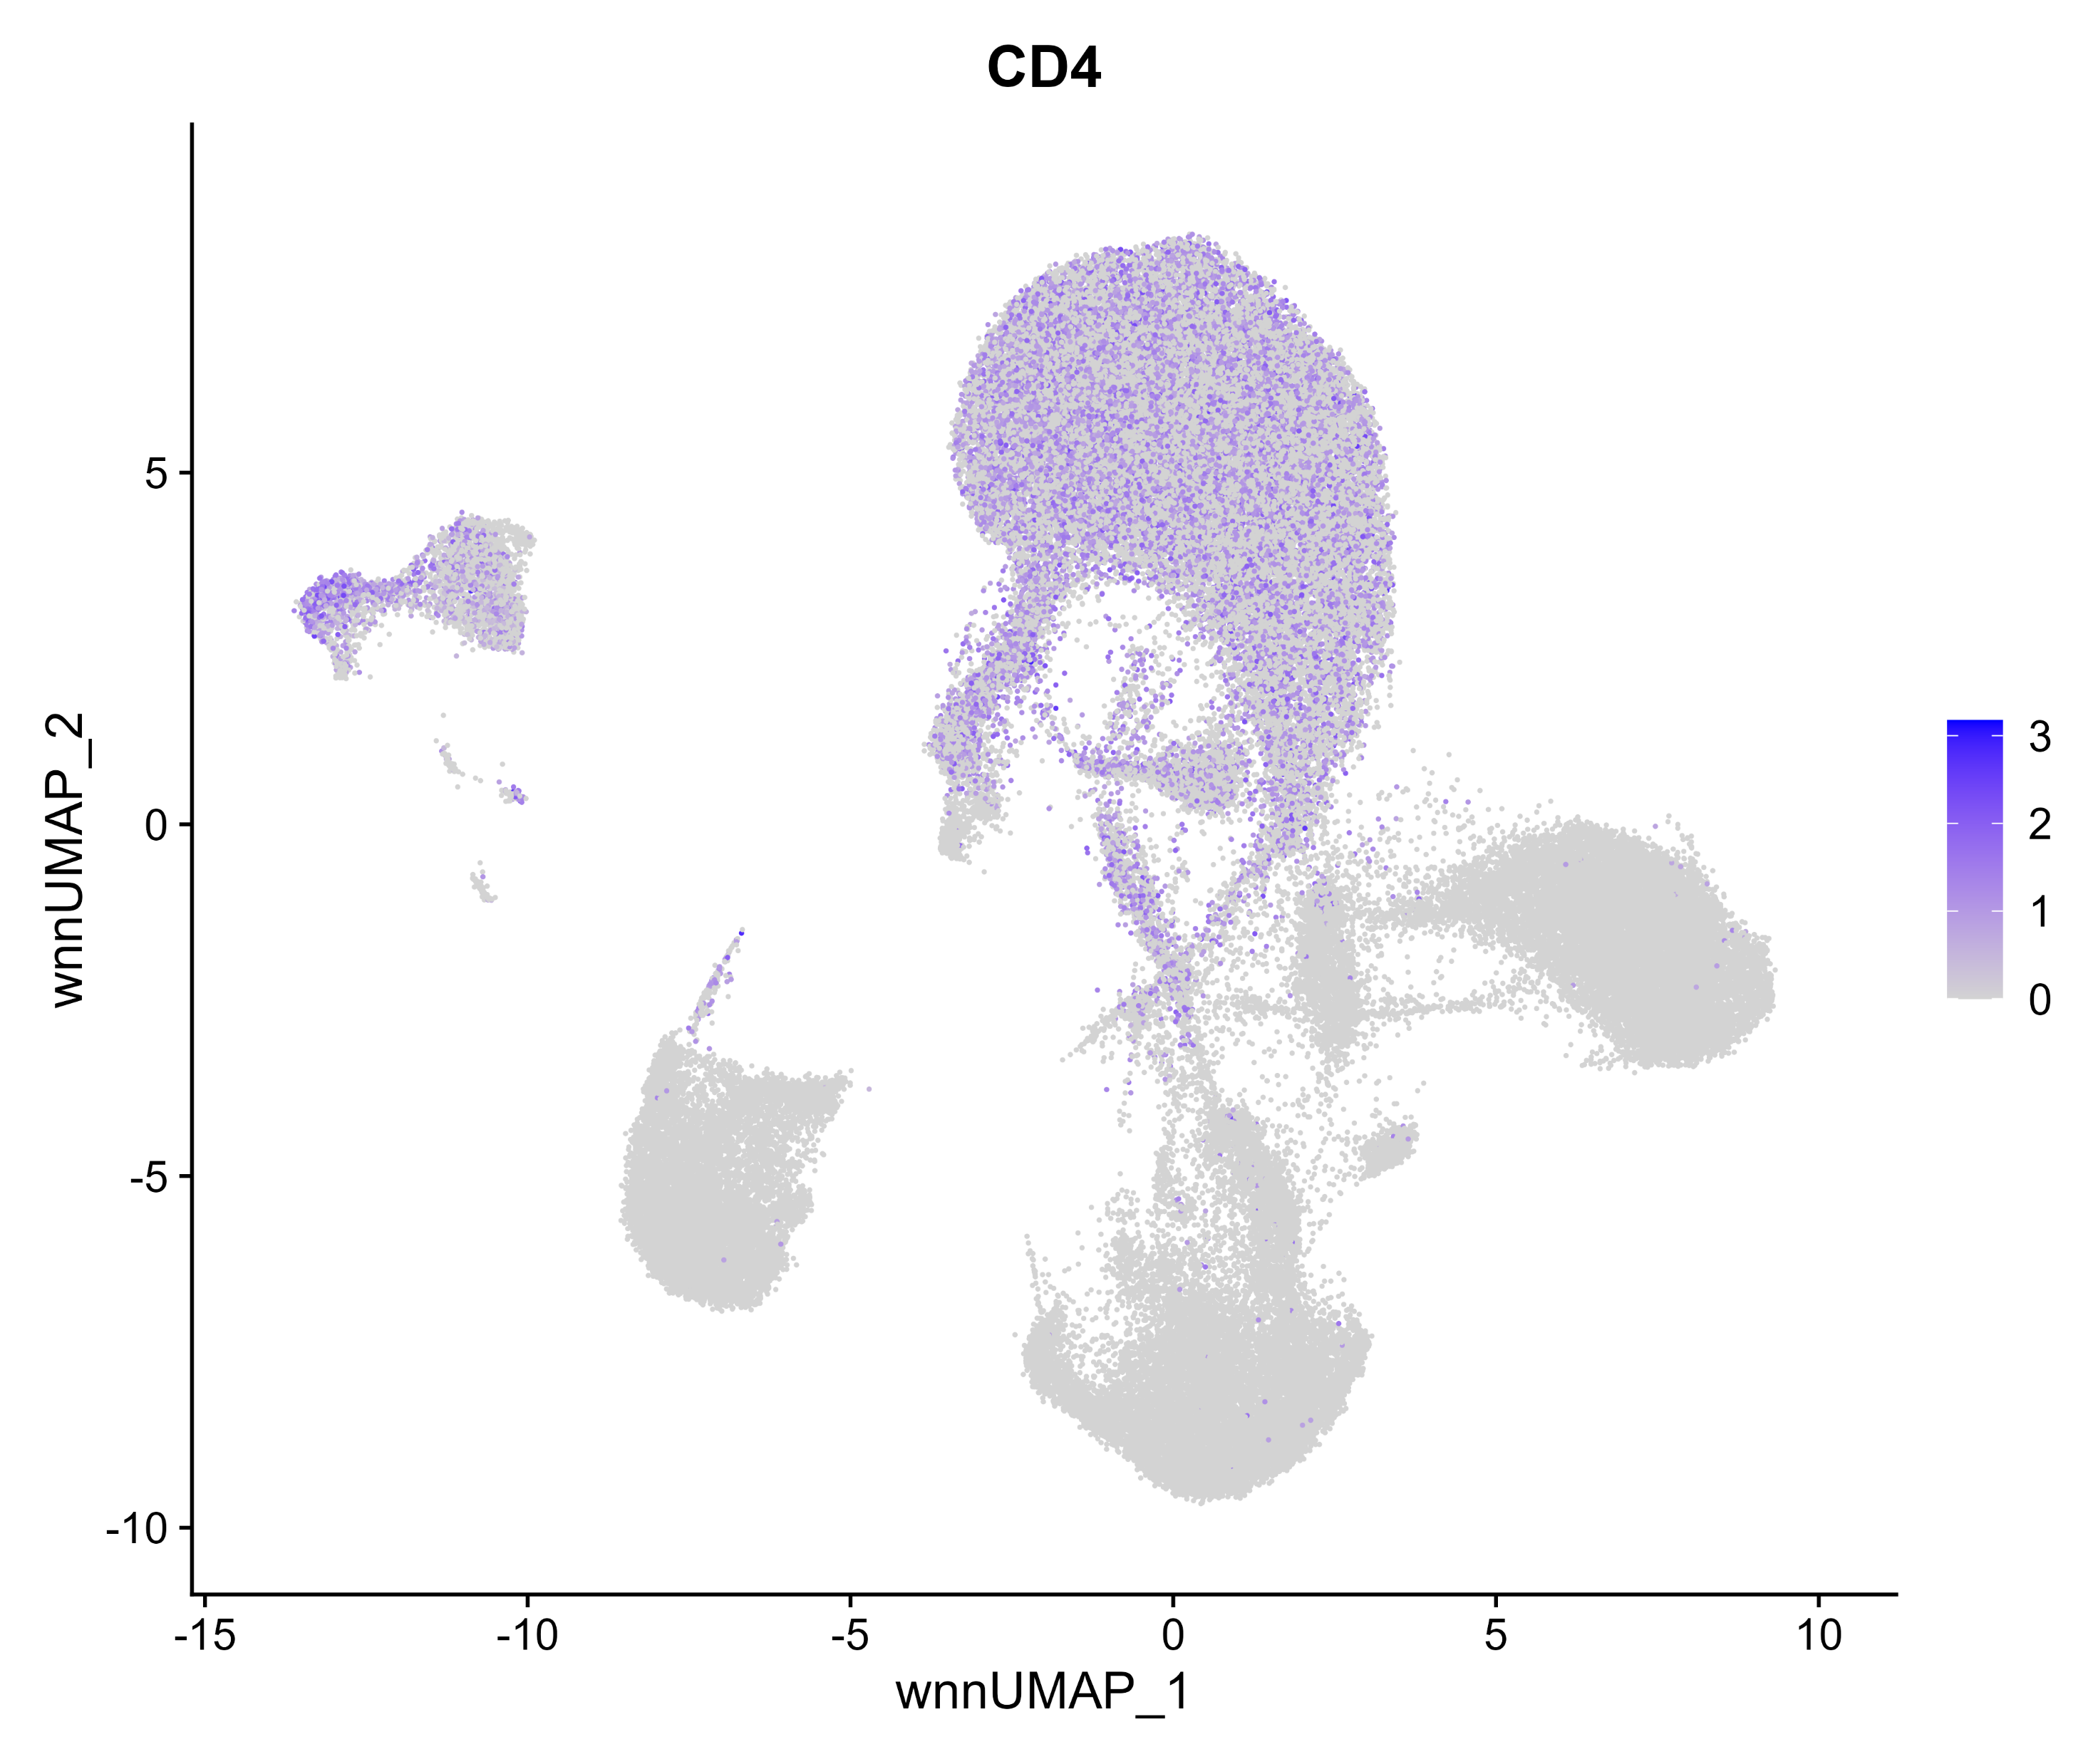
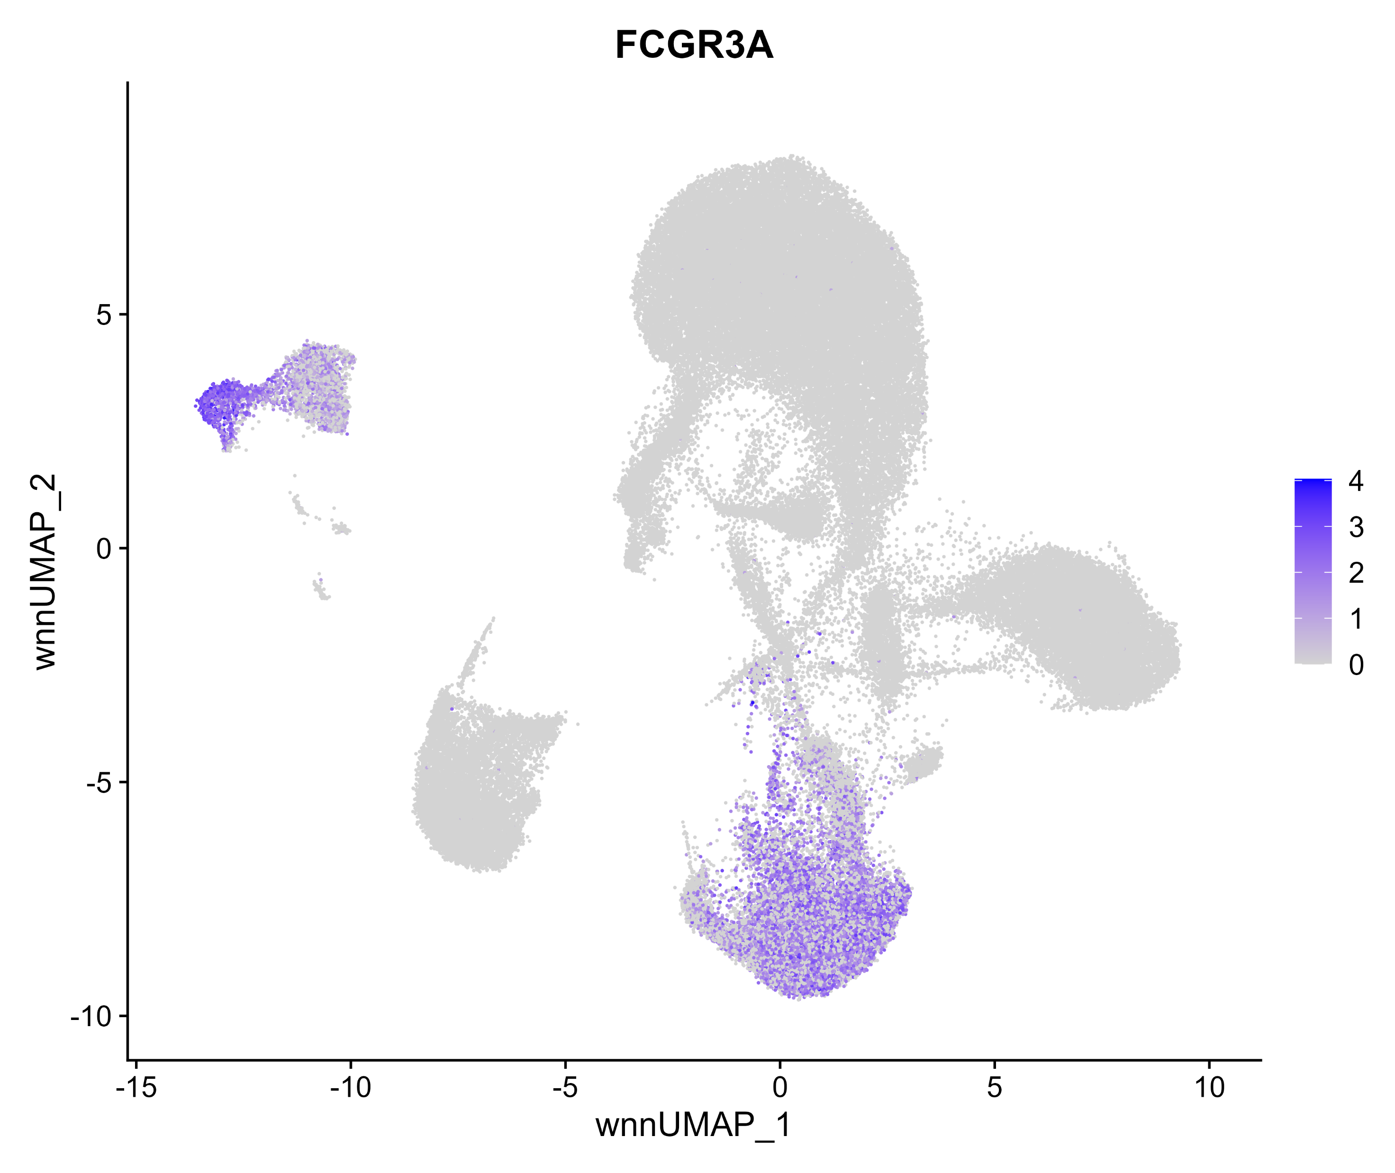
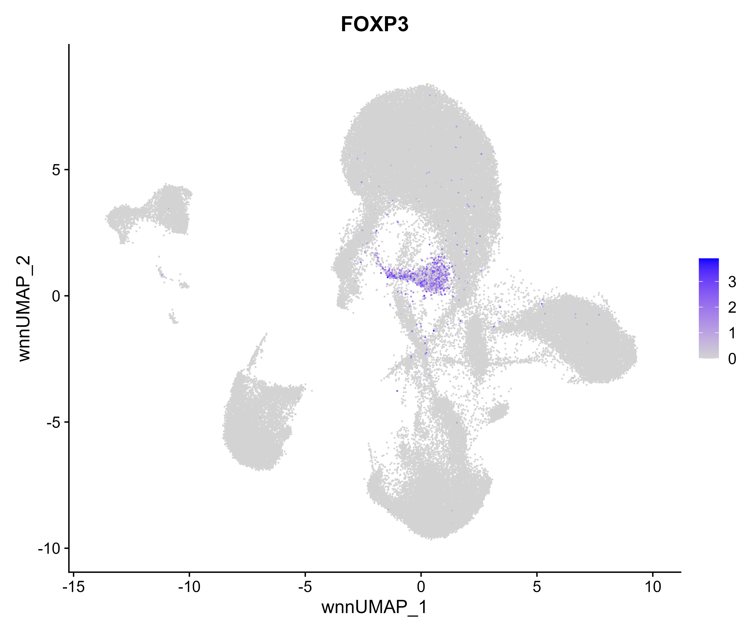
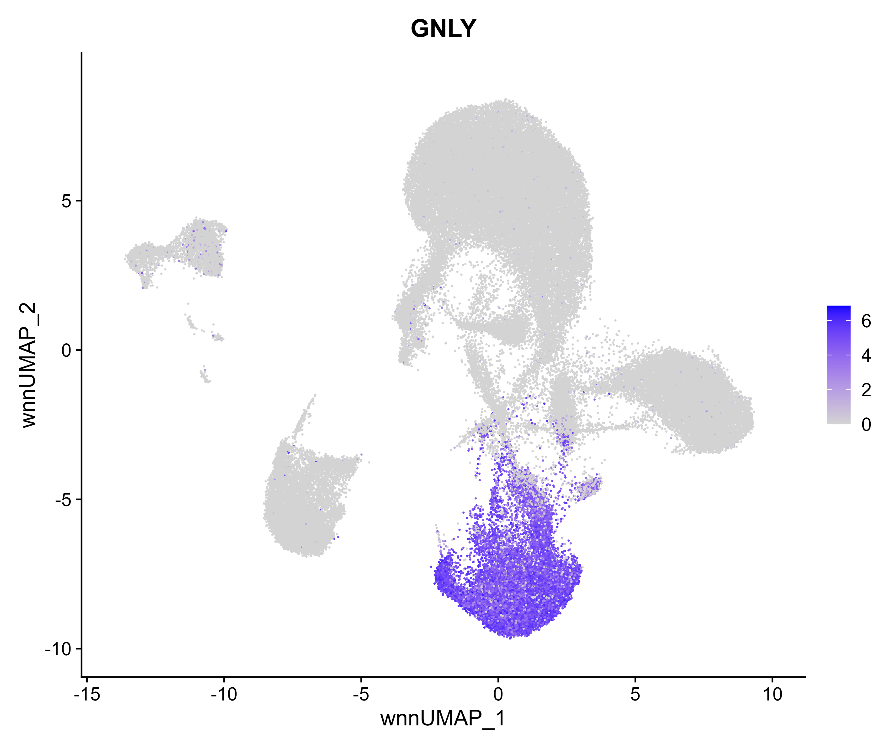
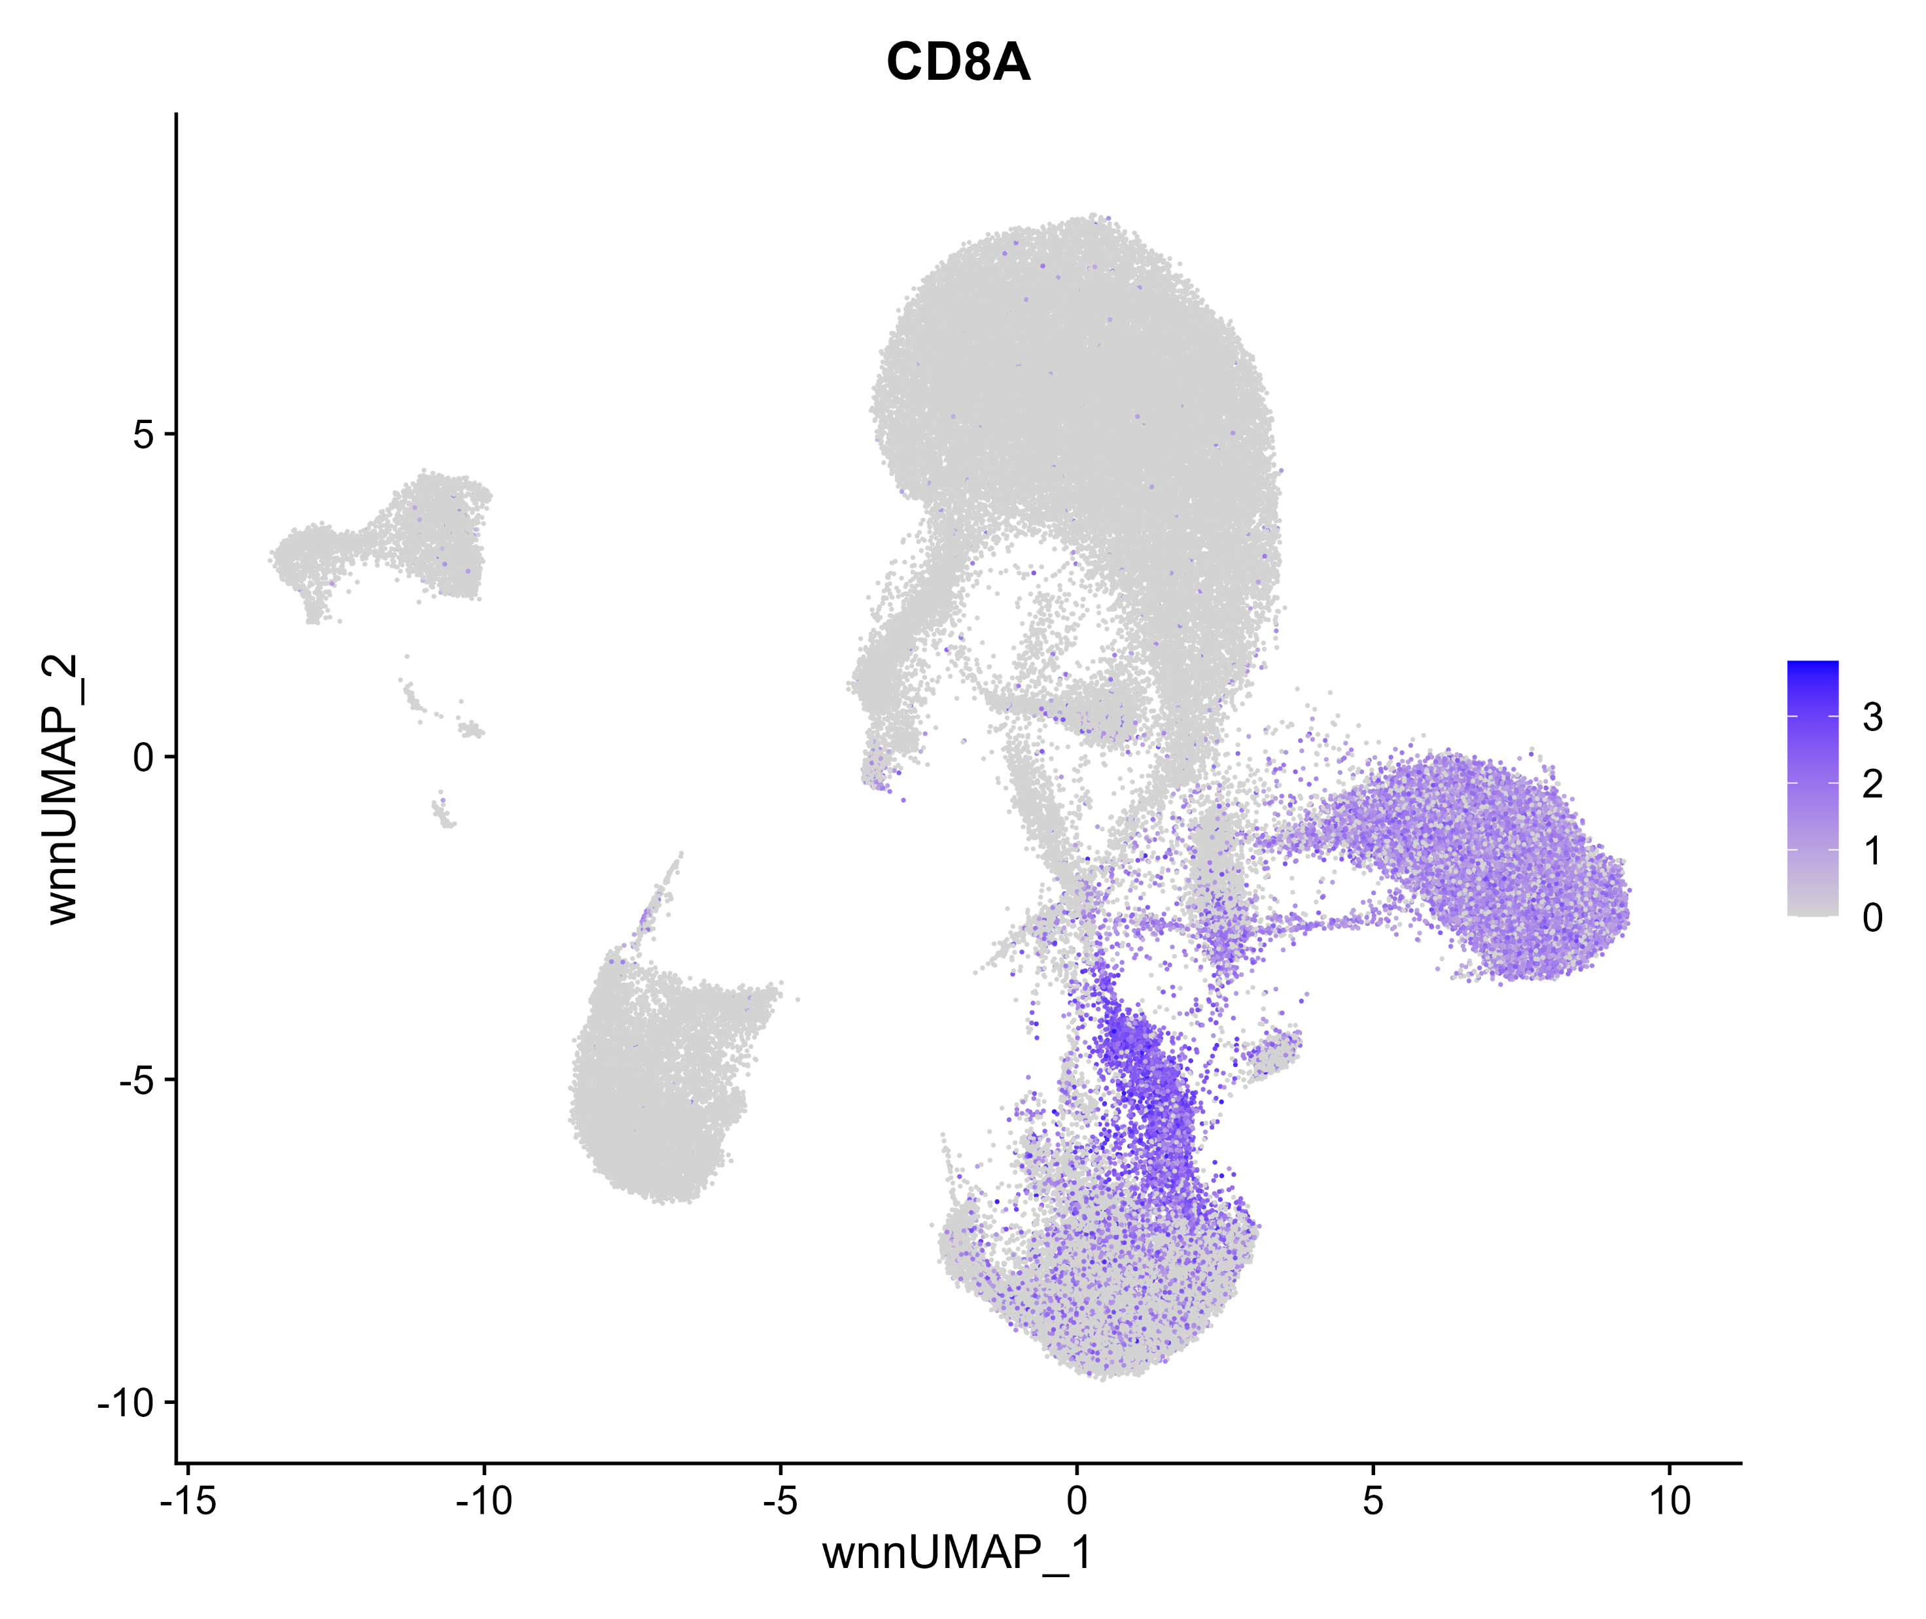
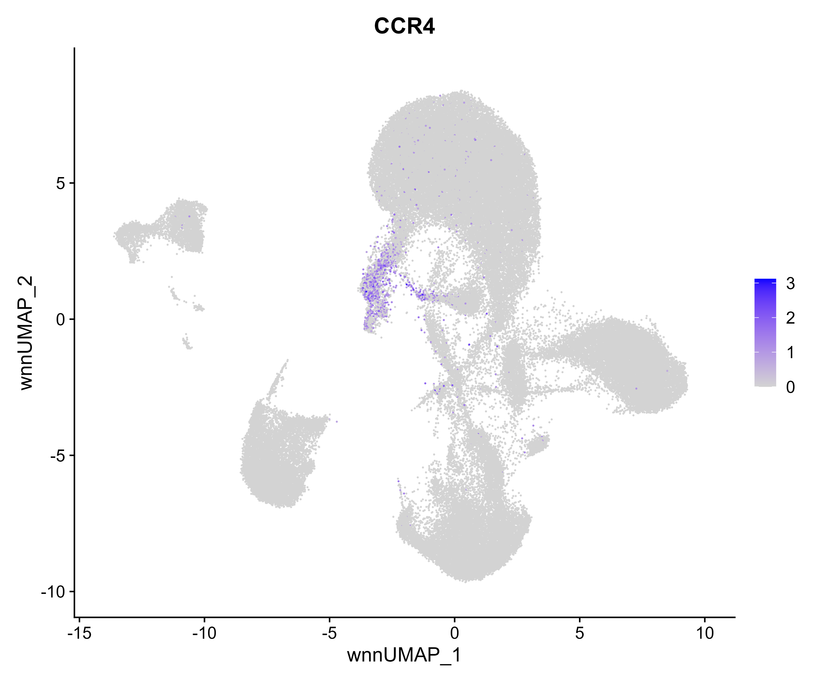



Cluster Plot 0.8
Cluster Plot Azimuth 2
CD14
CD19
CD3D
CD4
CD16
FOXP3
GNLY
CD8A
CCR4
PRF1
MS4A1
TRDV1
Notes:
Supplementary Figure 6.

Slide 17


A
B
C
Notes:
Supplementary Figure 7

Slide 18






